Slide 1










SasView
An
“open, collaborative, community development” platform for
Small Angle Scattering Data Analysis

Slide 2
SasView
Data Analysis eh?
…. So what exactly does that mean?
Only works on Reduced data
(All the instrumental artifacts are removed and only the science is left)
…. Sorta
Focus on analytical approaches for this package
…. Sorta
Whatever anybody puts into it
…. Sorta

Slide 3





A little history …
Heritage: NIST IGOR macros
SansView is DANSE project output
~ 8.5% of funds were for SANS
+ BUMPS … see later
2006
2011
2012
NIST Supported initial transition from NSF funding
2013
Transition to Community project.
1st Code Camp at NIST April 2013
2014
2nd Code Camp at ISIS April 2014
Move to GitHub
v3.0 released
3rd Code Camp at ESS Feb 2015
2015
Rename to SasView
v3.1 released
2016
4th Code Camp at TU Delft March 2016
v4.0 released
5th Code Camp at ORNL Oct 2016
v4.1 released
6th Code Camp at ILL/ESRF April 2017
2017
7th Code Camp at DMSC October 2017
8th Code Camp at ESS Sept 2018
2018
v5.0b1 released
v4.2 released
1st SasView User Meeting at SAS2018
v4.2.1 released
2019
v5.0b2 released
9th Code Camp at ILL/ESRF March 2019

Slide 4
So … What Can SasView Do Currently?

Slide 5
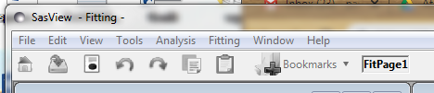
Perspectives on the data
Tools
Data Operation
SLD calculator
Density/Volume calculator
Slit Size Calculator
Kiessig Thickness Calculator
Q Resolution Estimator
Generic Scattering calculator
Orientation Viewer
Python Shell/Editor
Image Viewer
File Converter
Analysis
Fitting
Invariant
Pr Inversion
Correlation Function

Slide 6
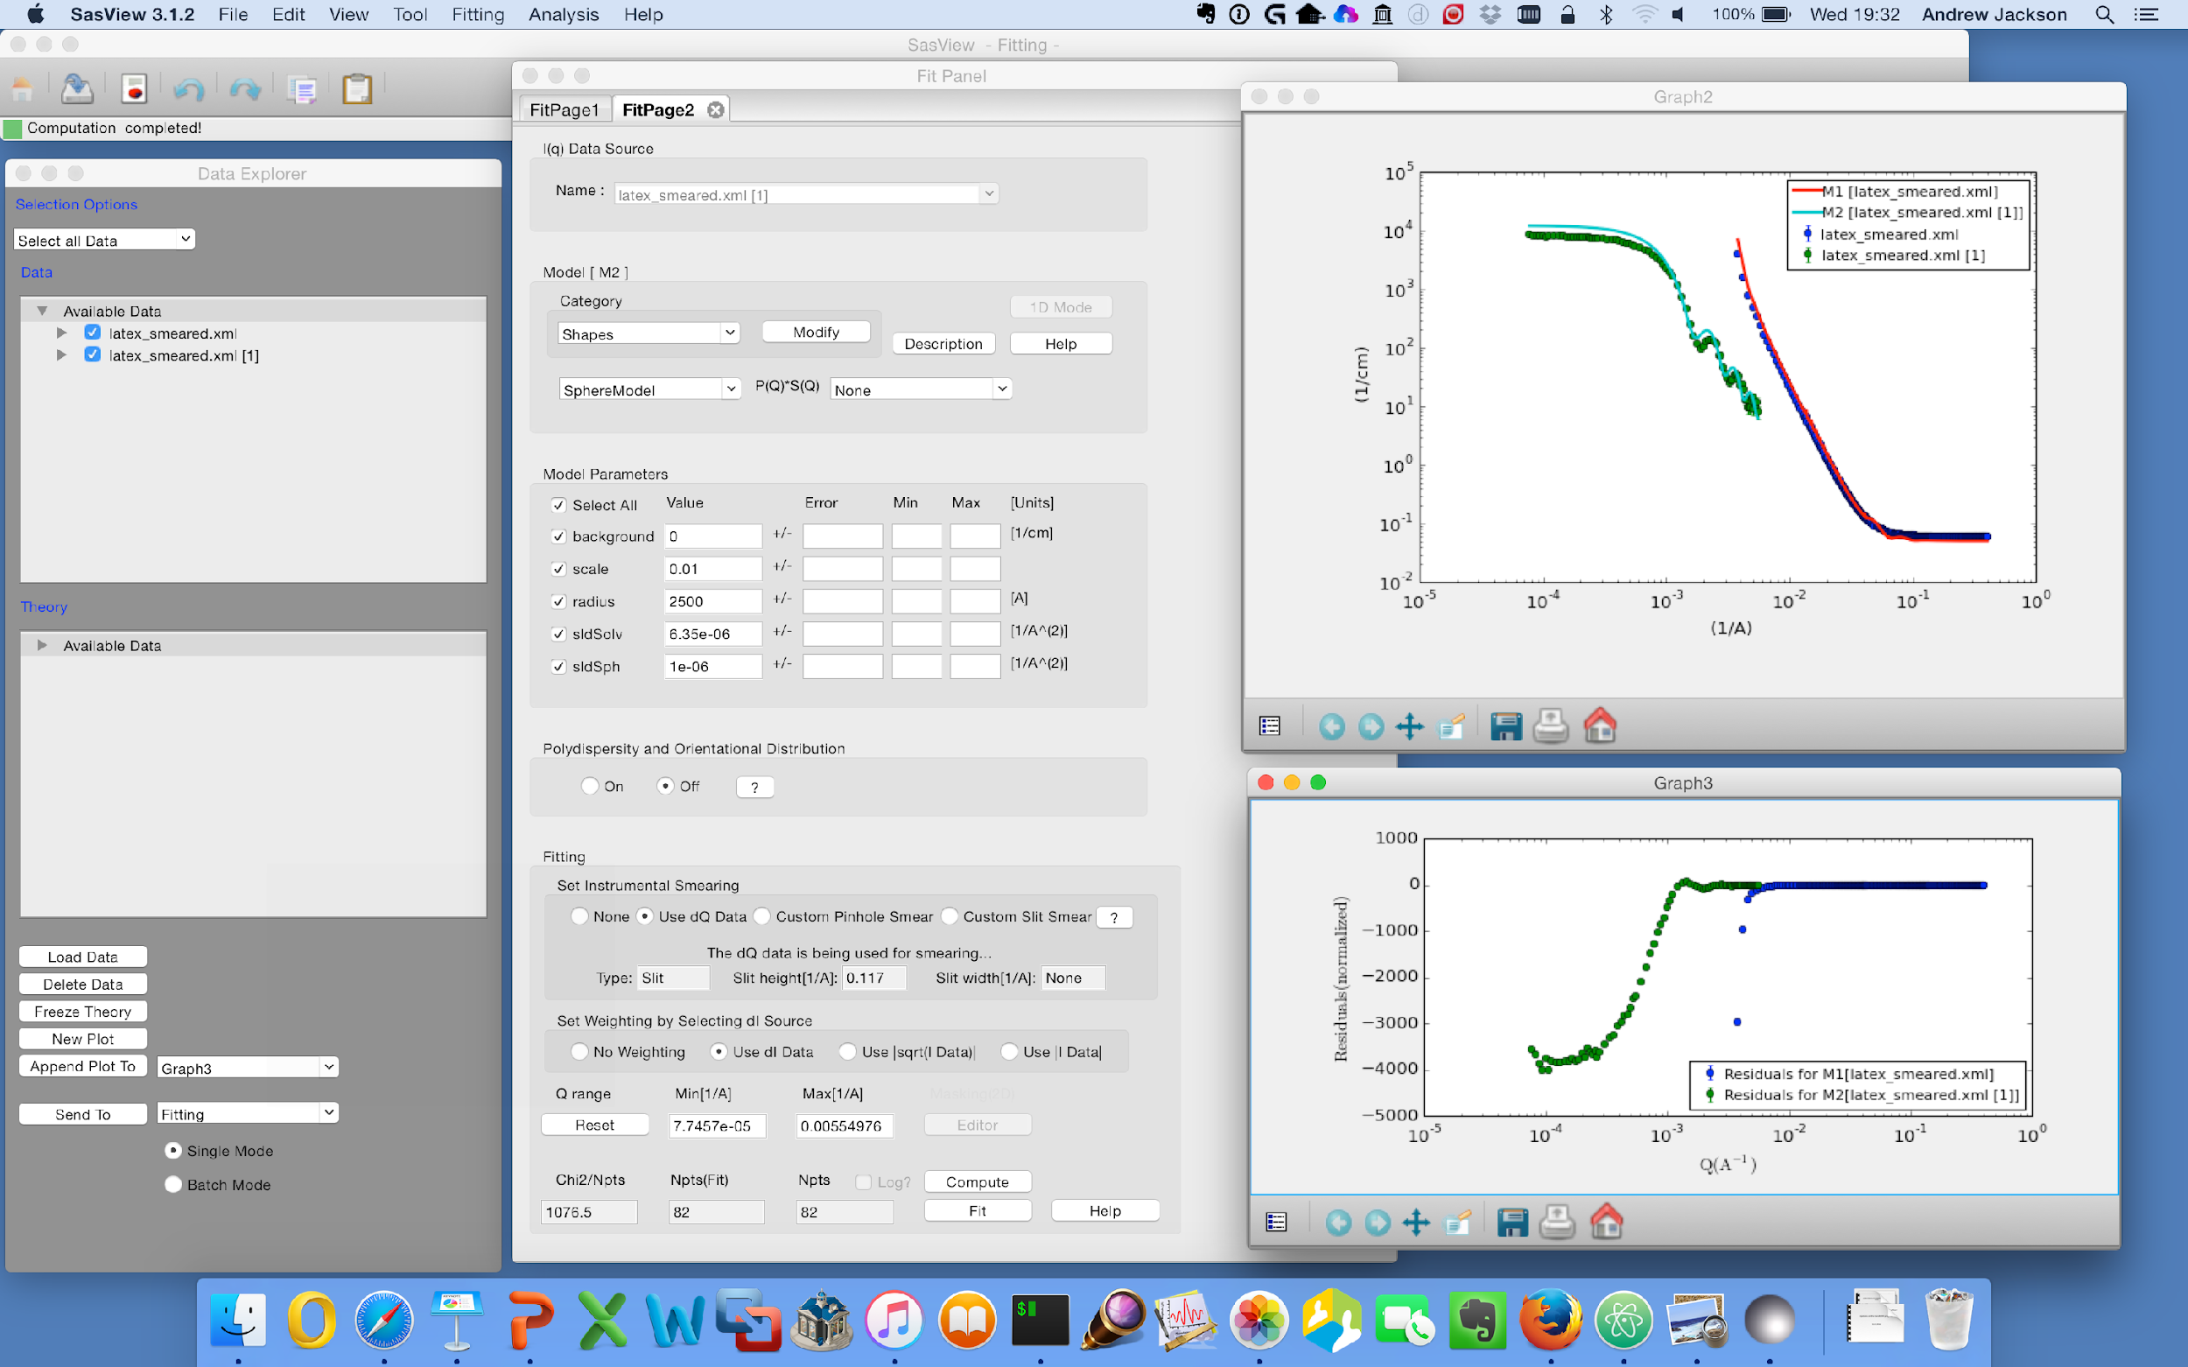
1D Analysis
Data management
Common data formats supported, including NXCansas & cansas1D
Wide choice of built-in models (> 70)
P(Q), S(Q) & P(Q)*S(Q)
Simultaneous fitting
Analysis Tool Choice
&
Plotting
Generic parameter polydispersity
Choice of distribution and distribution parameters
Resolution smearing (pinhole and slit)
Automatically from data or provide parameters

Slide 7
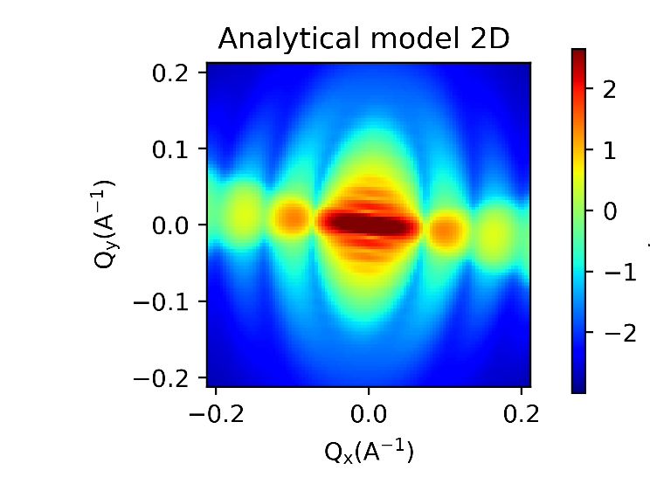
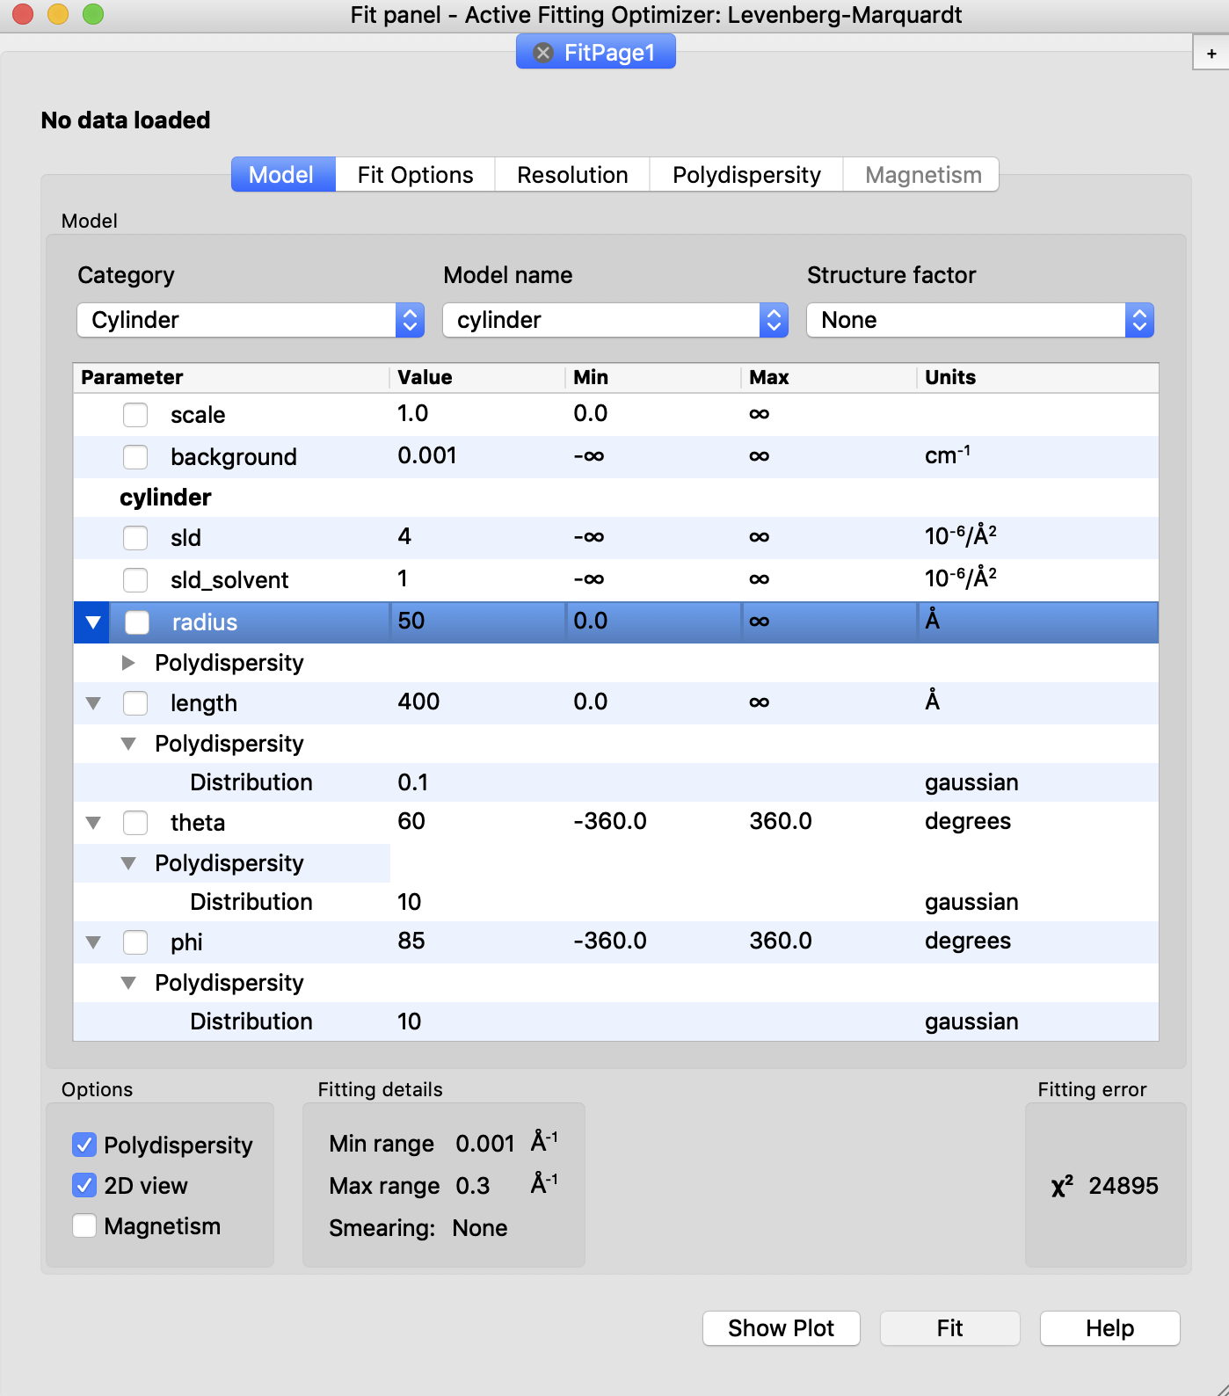
2D Analysis
Orientational polydispersity = “jitter”
Decouples the frame for the object’s orientation with respect to the beam and the “jitter” around the axis of the object.
Turning on GPU Option highly recommended for fitting

Slide 8
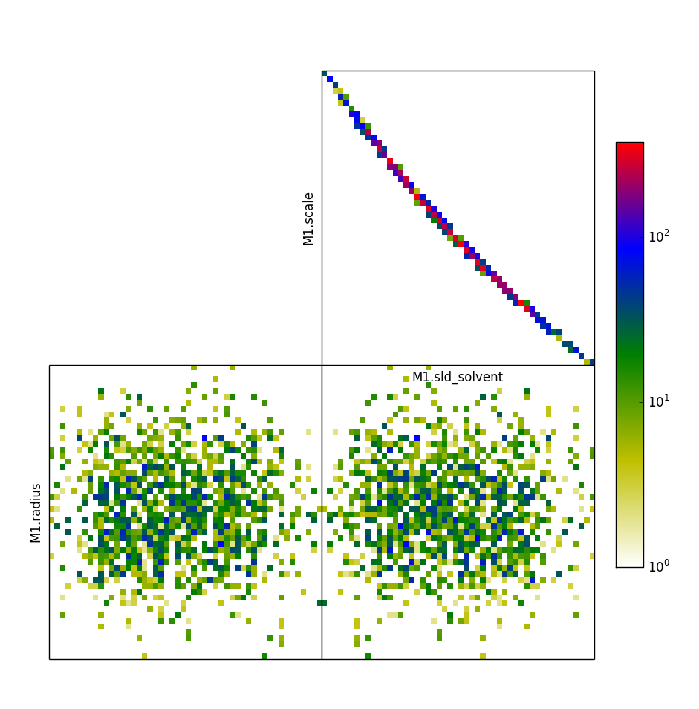
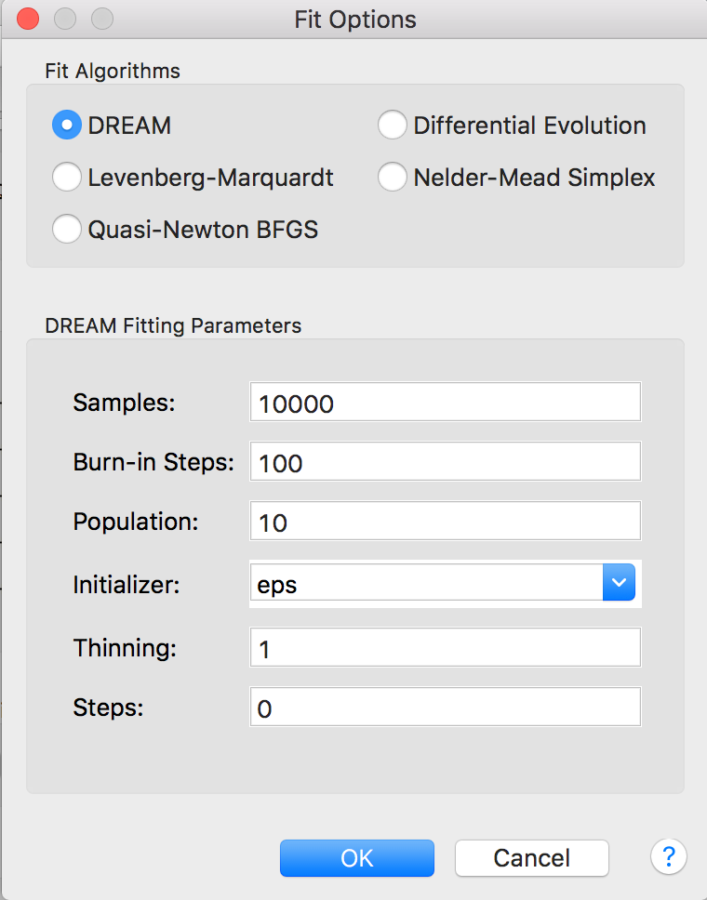
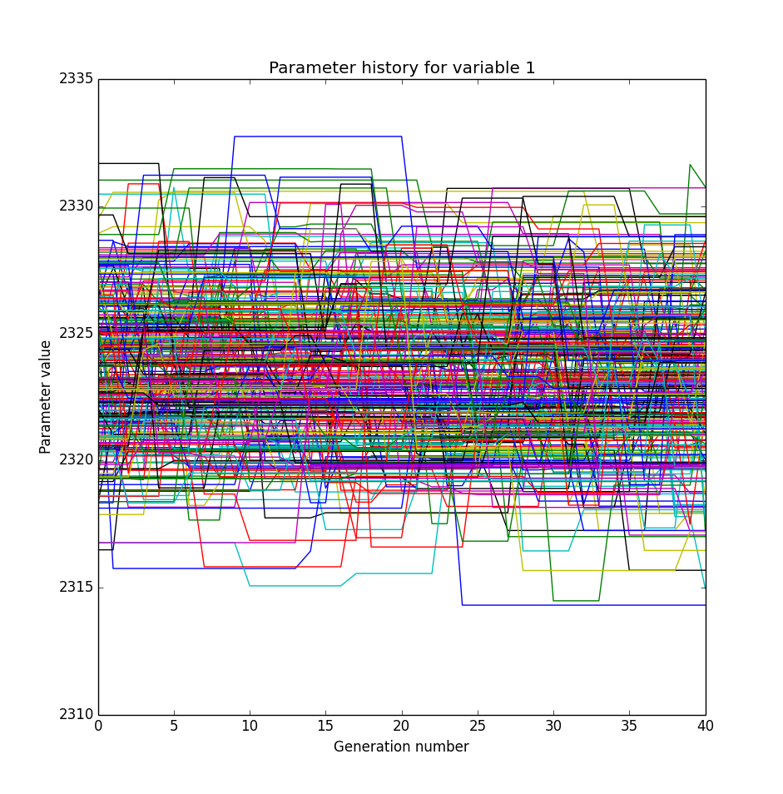
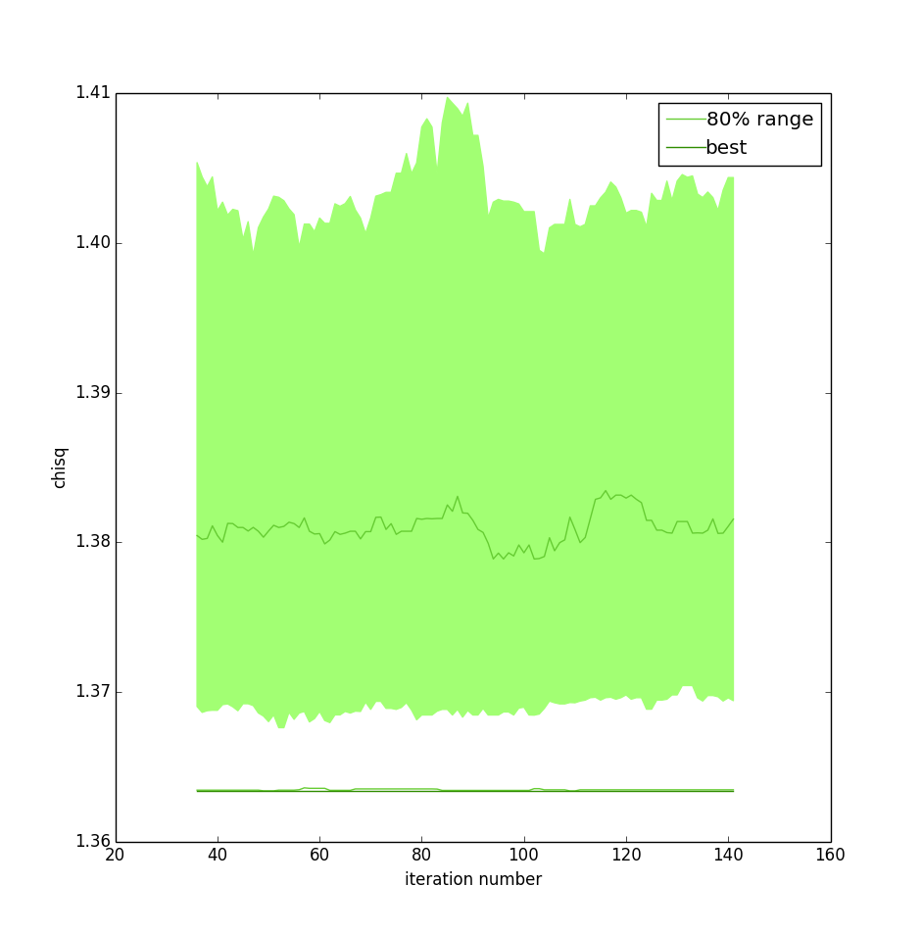
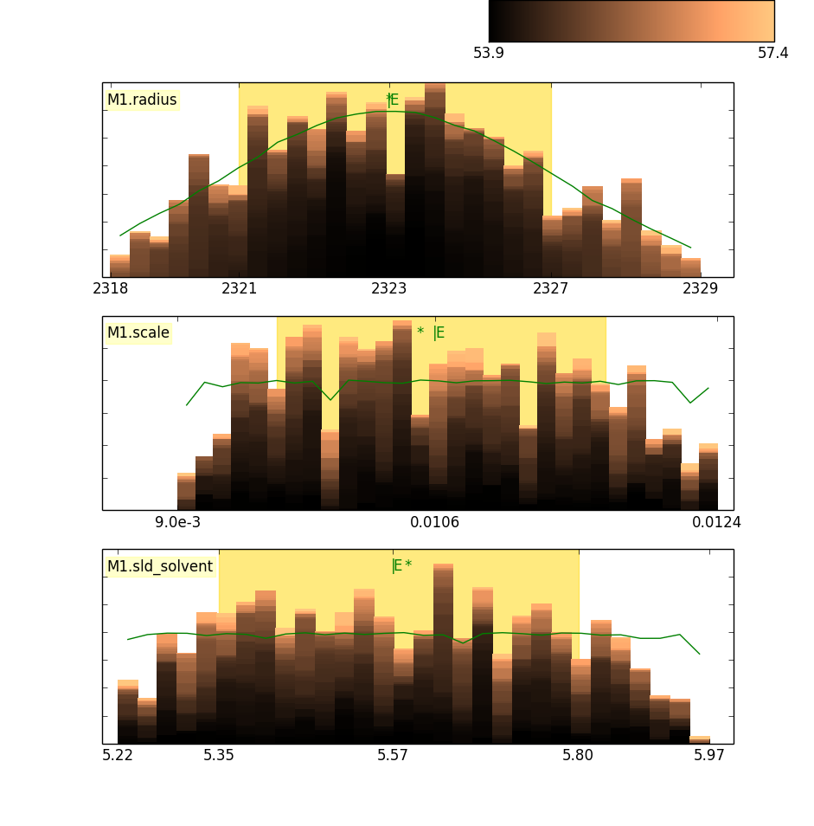
Fitting Algorithms
Uses bumps package from P. Kienzle
(also has DANSE origins)

Slide 9
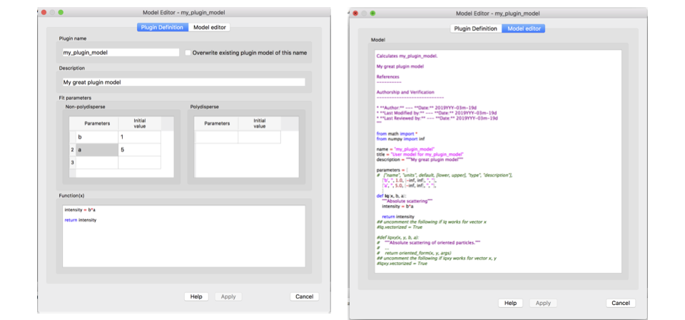
Plugin Model Editor

Slide 10
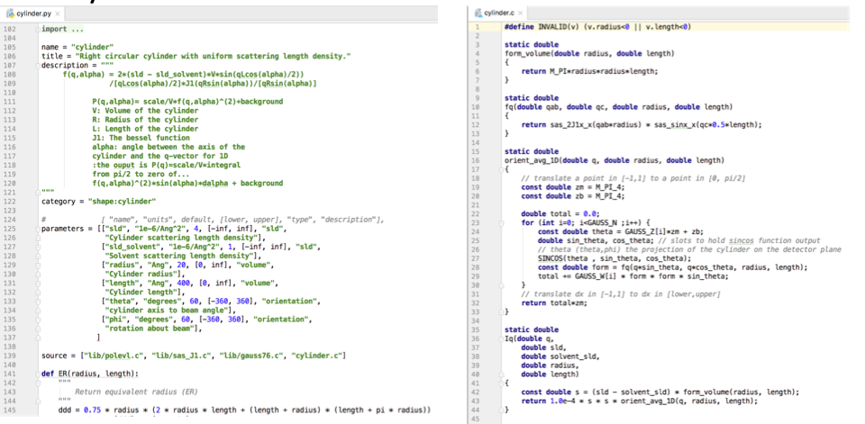
Python & C model files

Slide 11
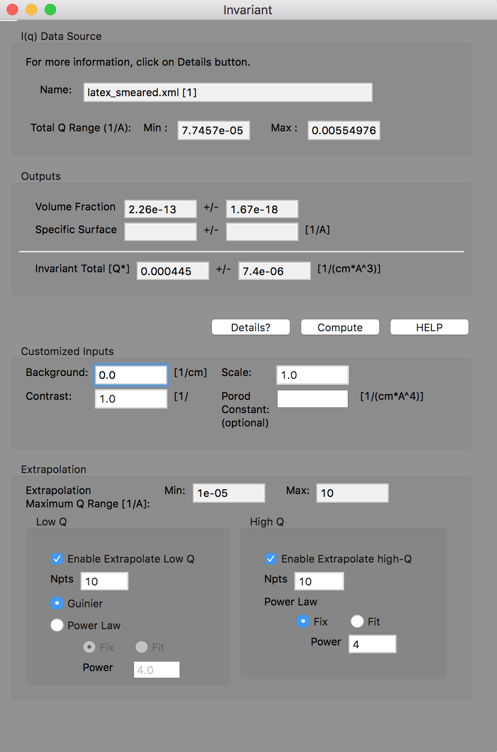
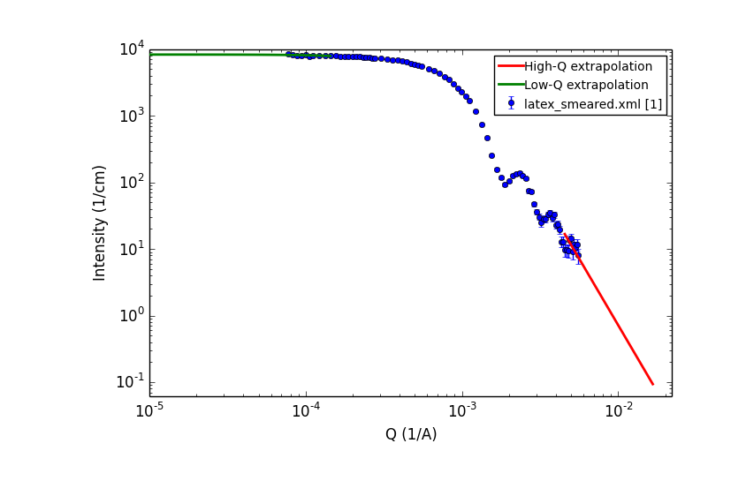
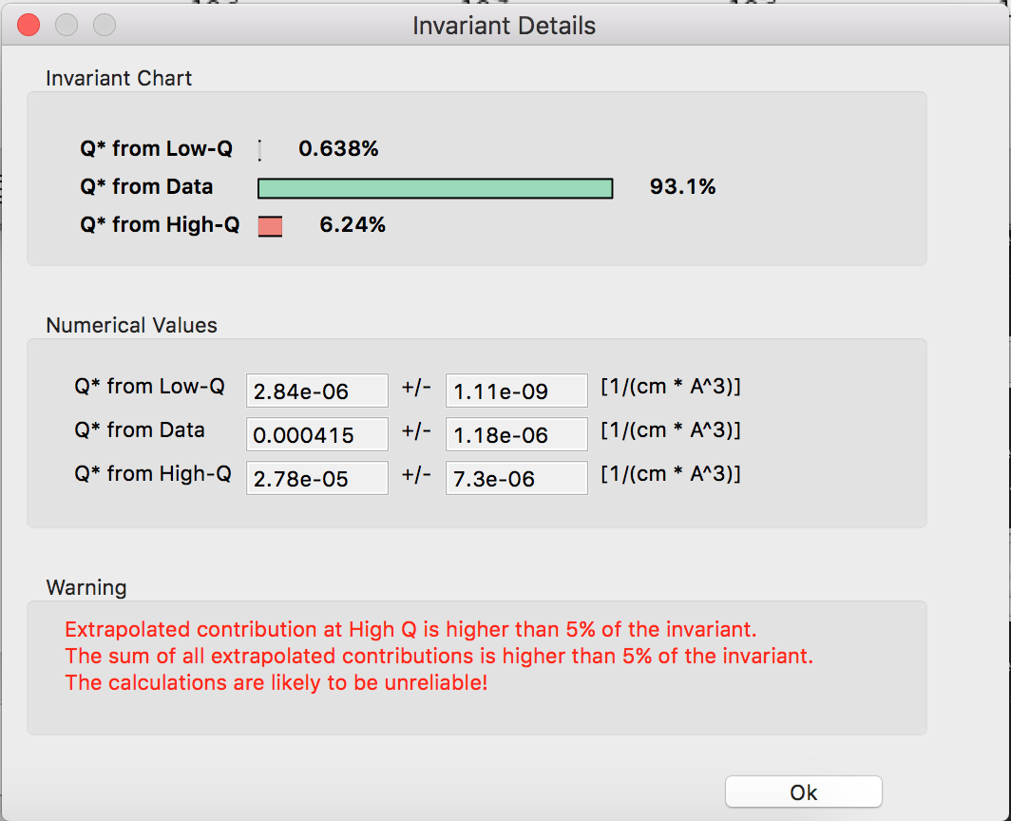
Invariant Calculation

Slide 12
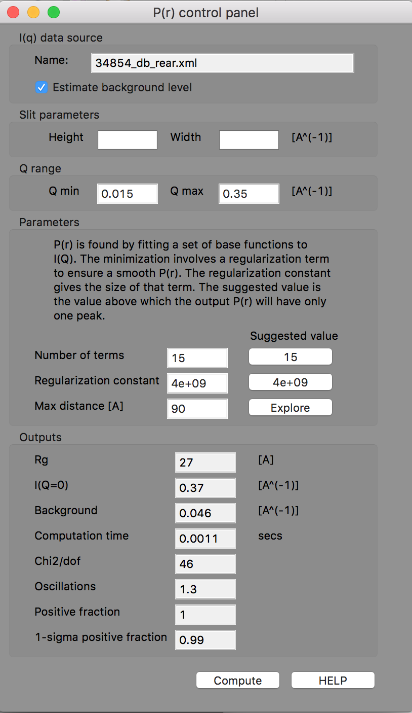
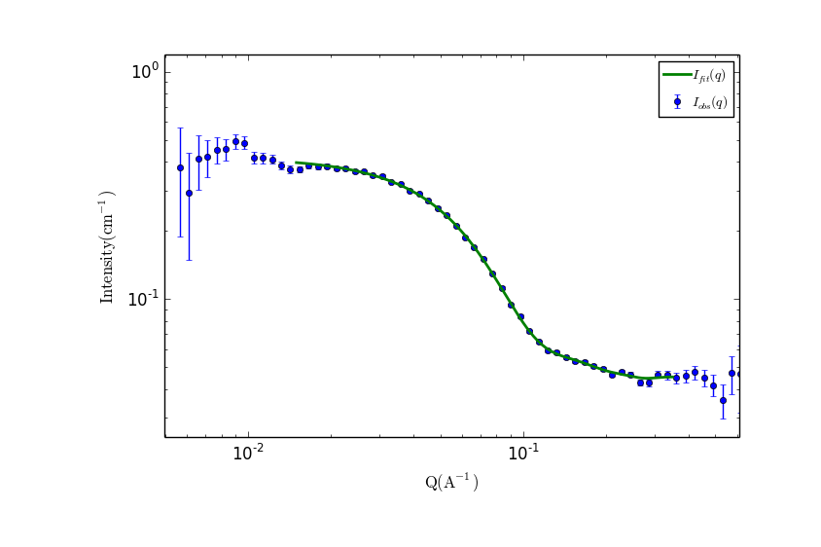
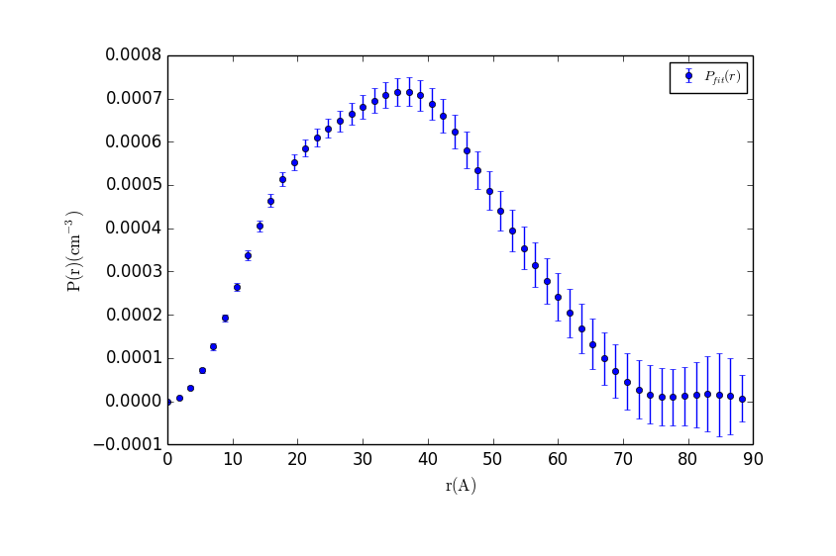
P(r) Inversion

Slide 13
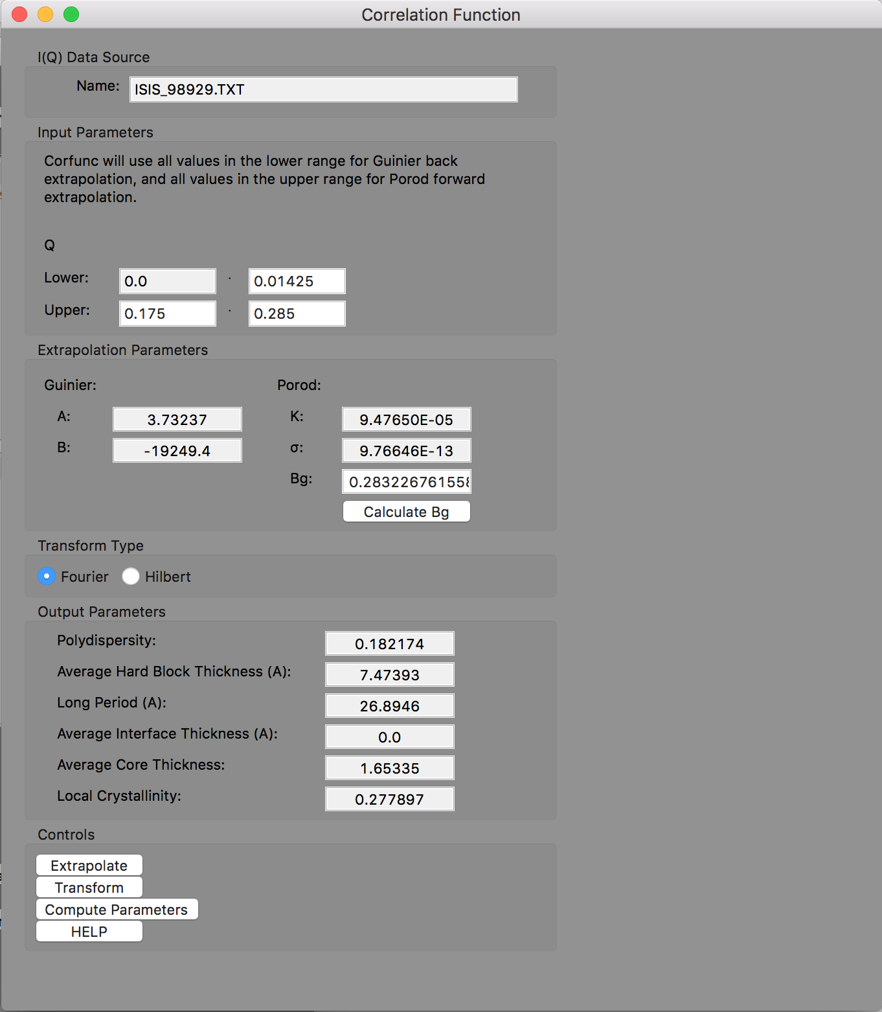
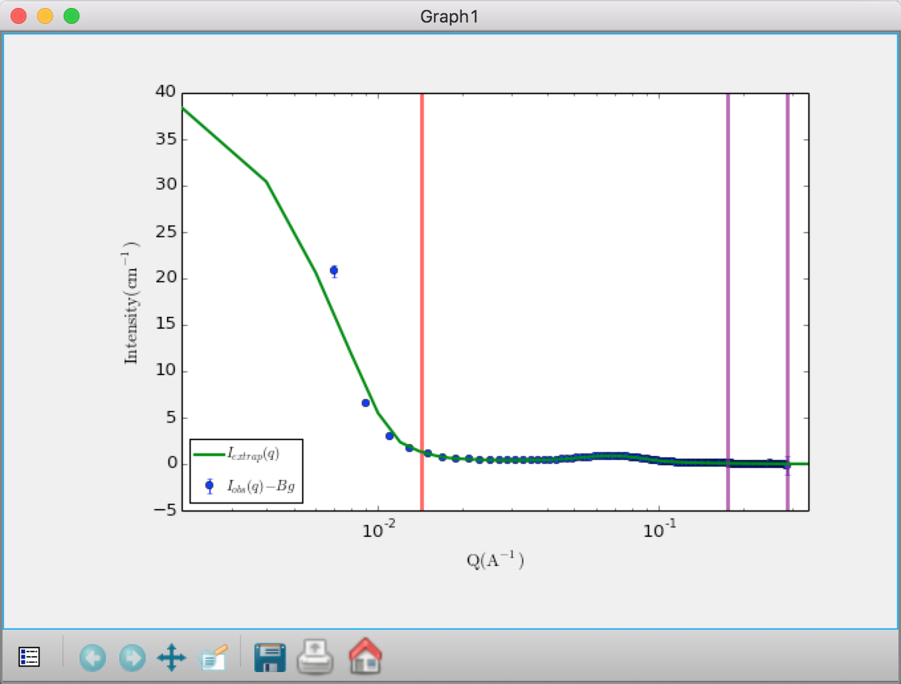
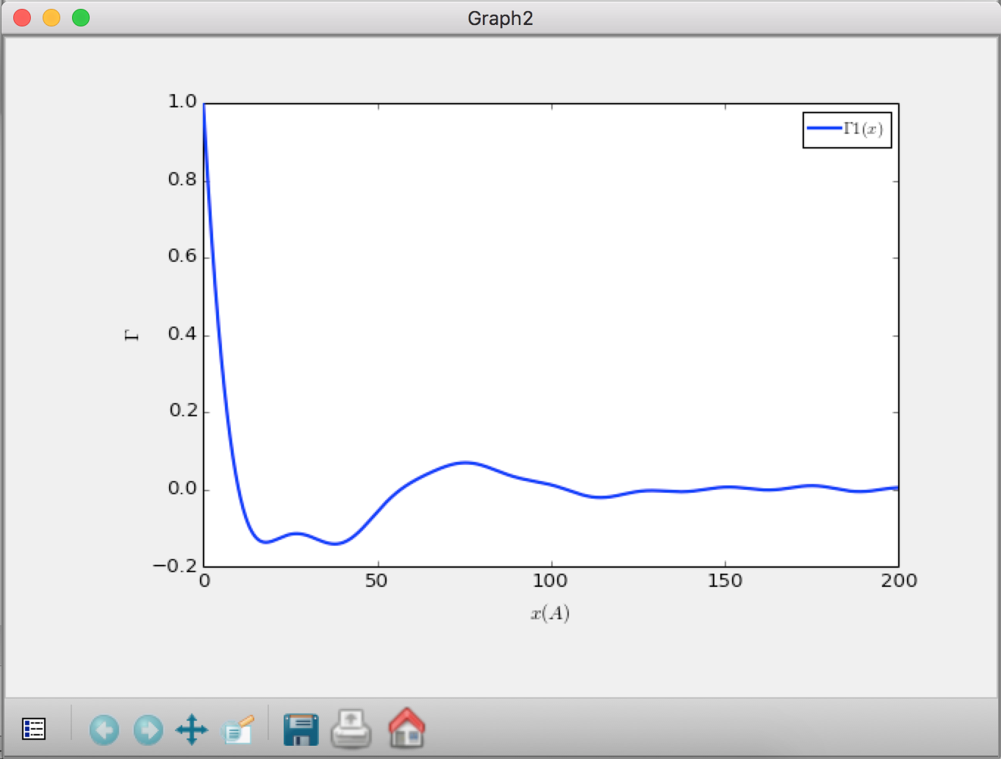
Correlation Function Analysis (new!)
CCP13 (Fiber Diffraction) legacy code (Fortran)
(ISIS summer student)

Slide 14
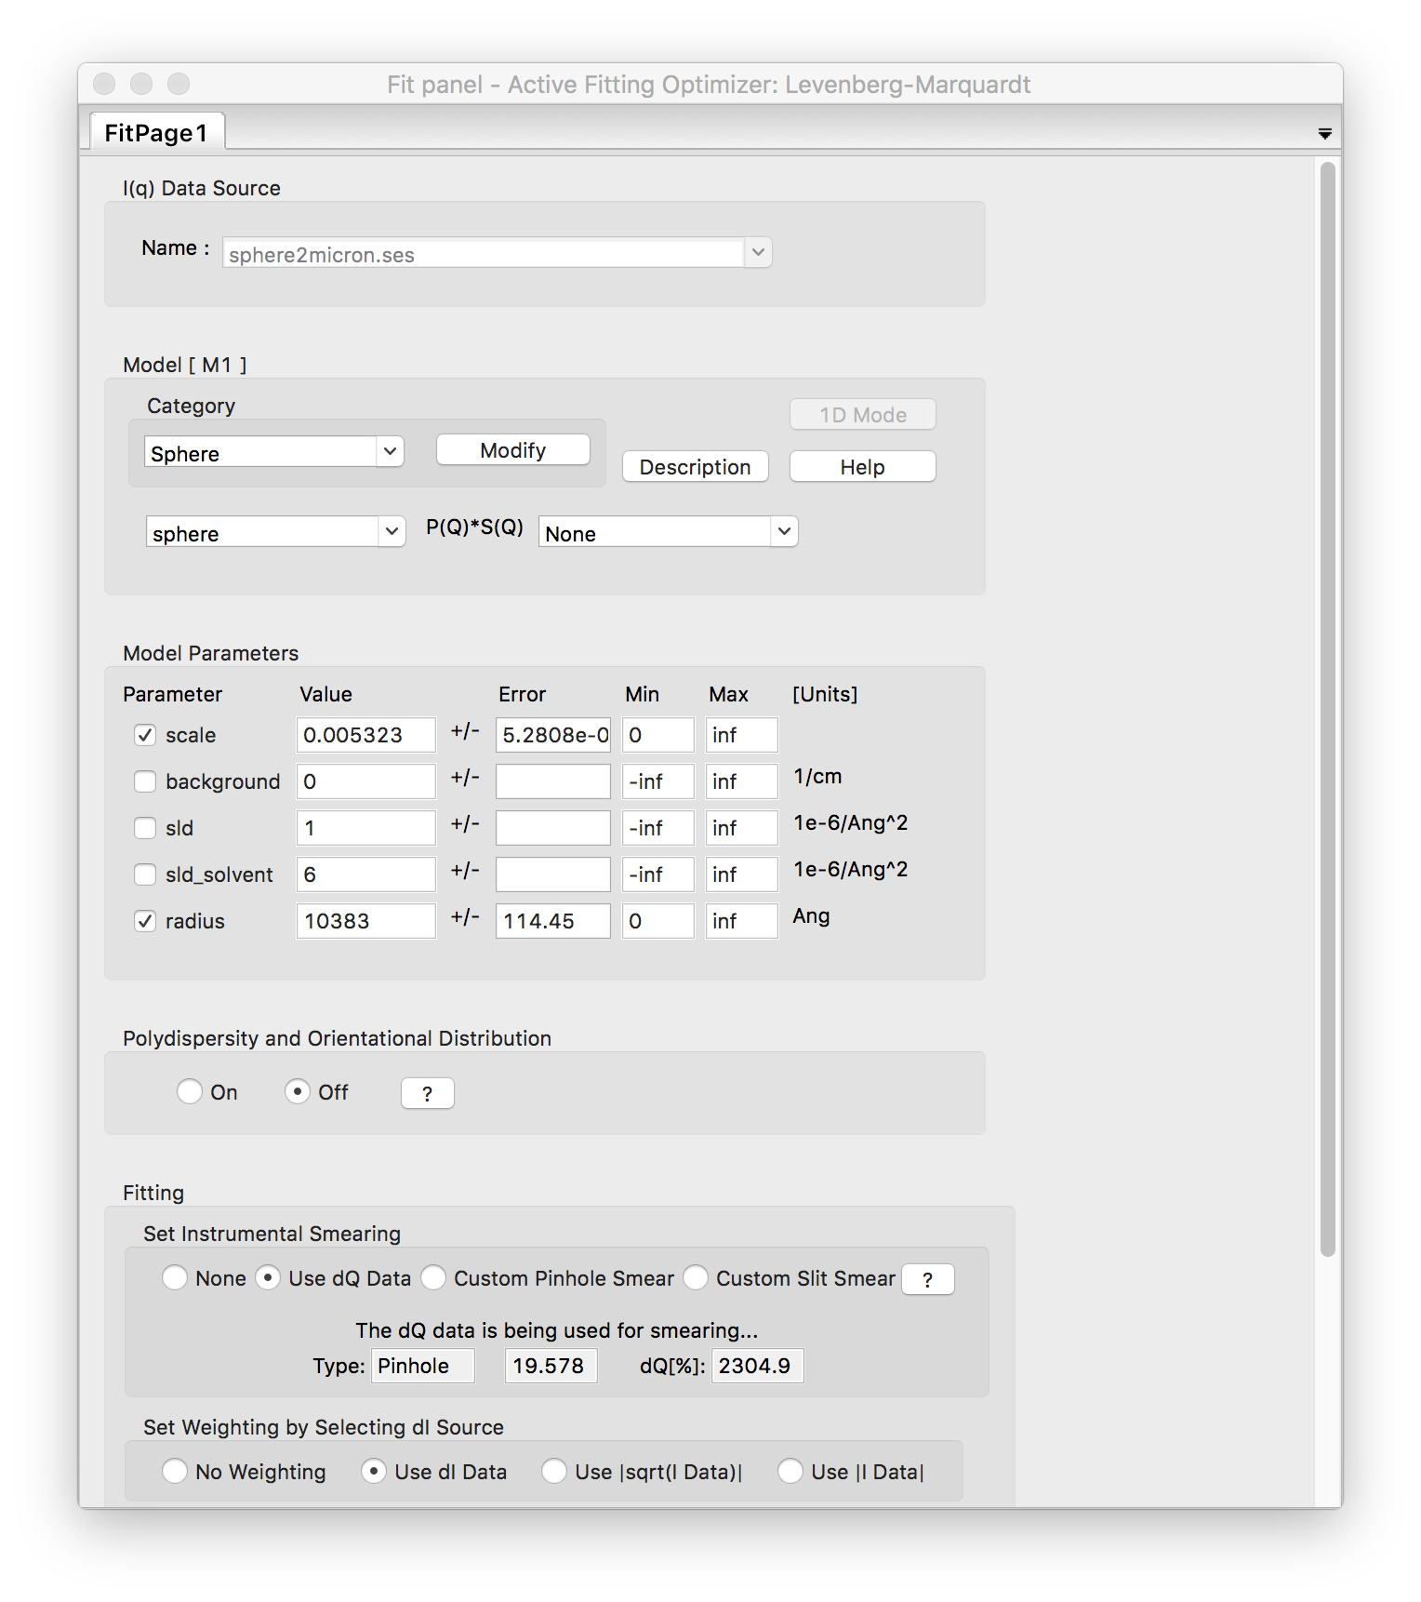
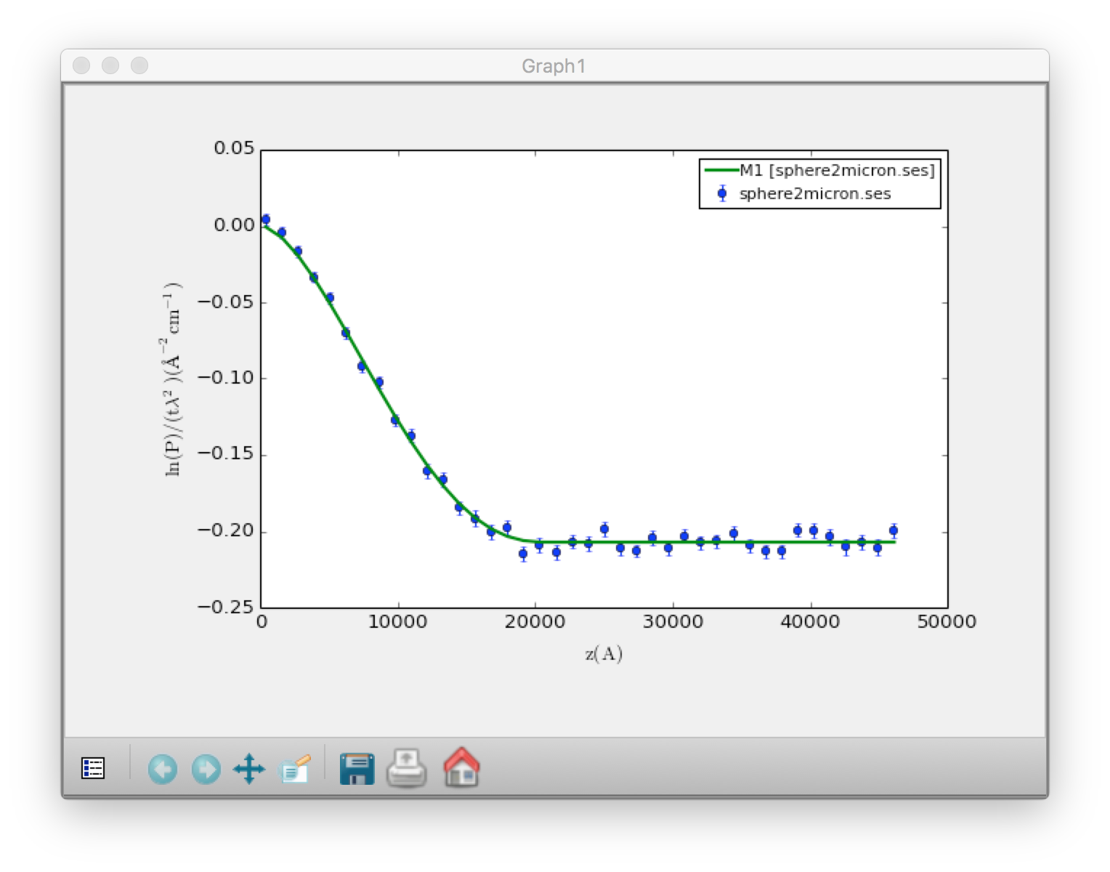
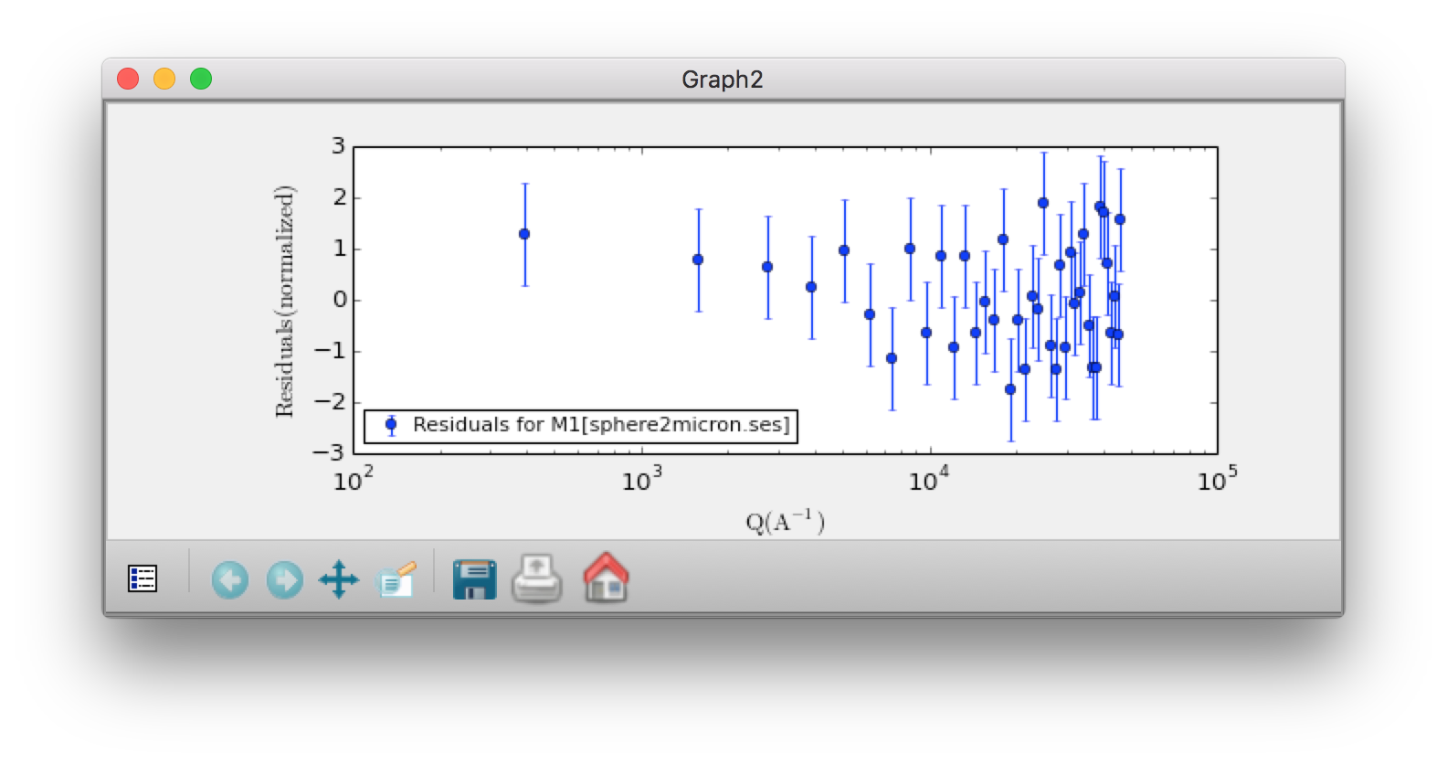
SESANS Analysis
Automatic Hankel Transform of SANS models
(TU Delft & ISIS)

Slide 15
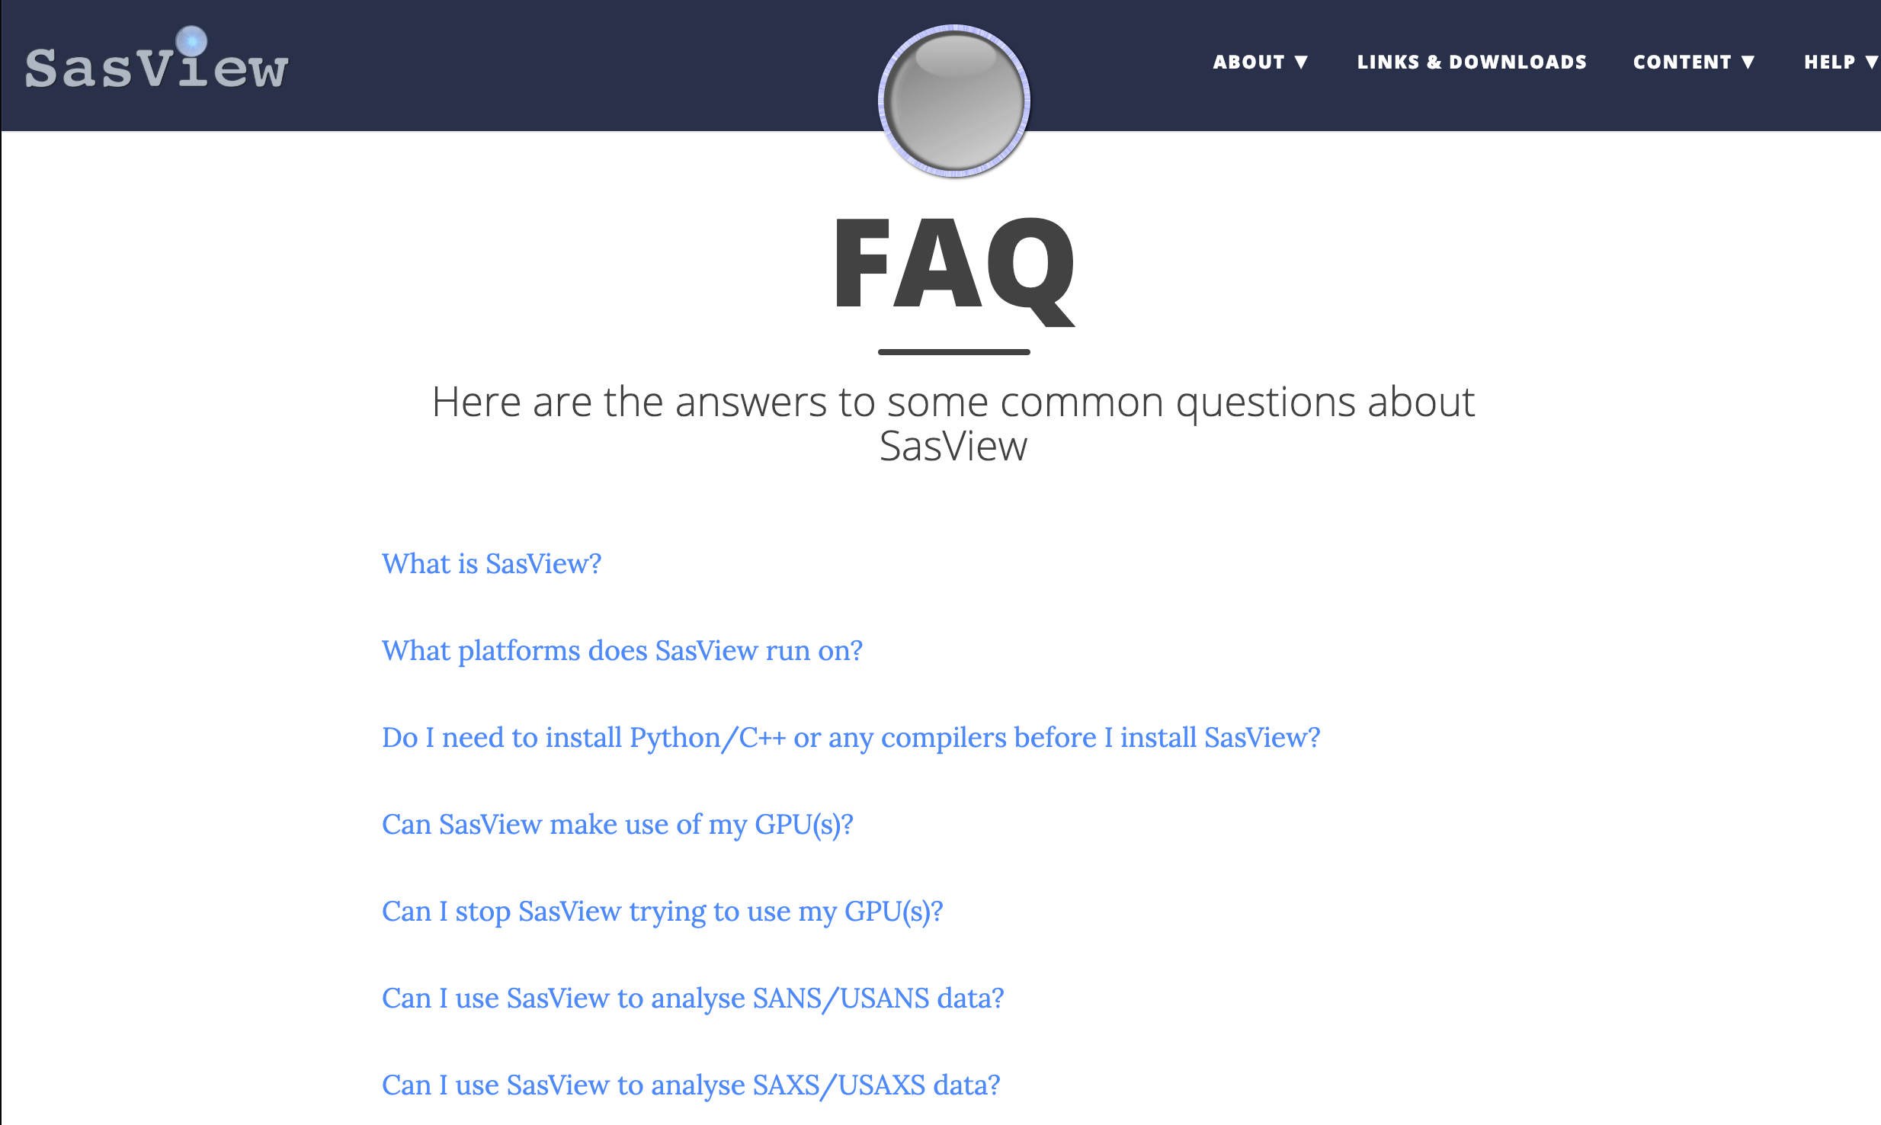
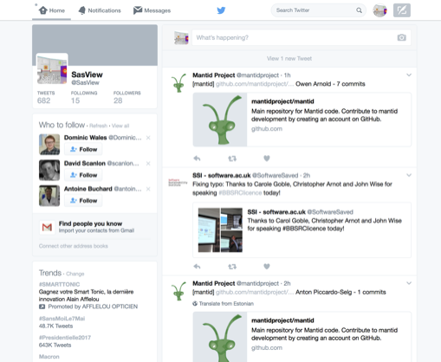
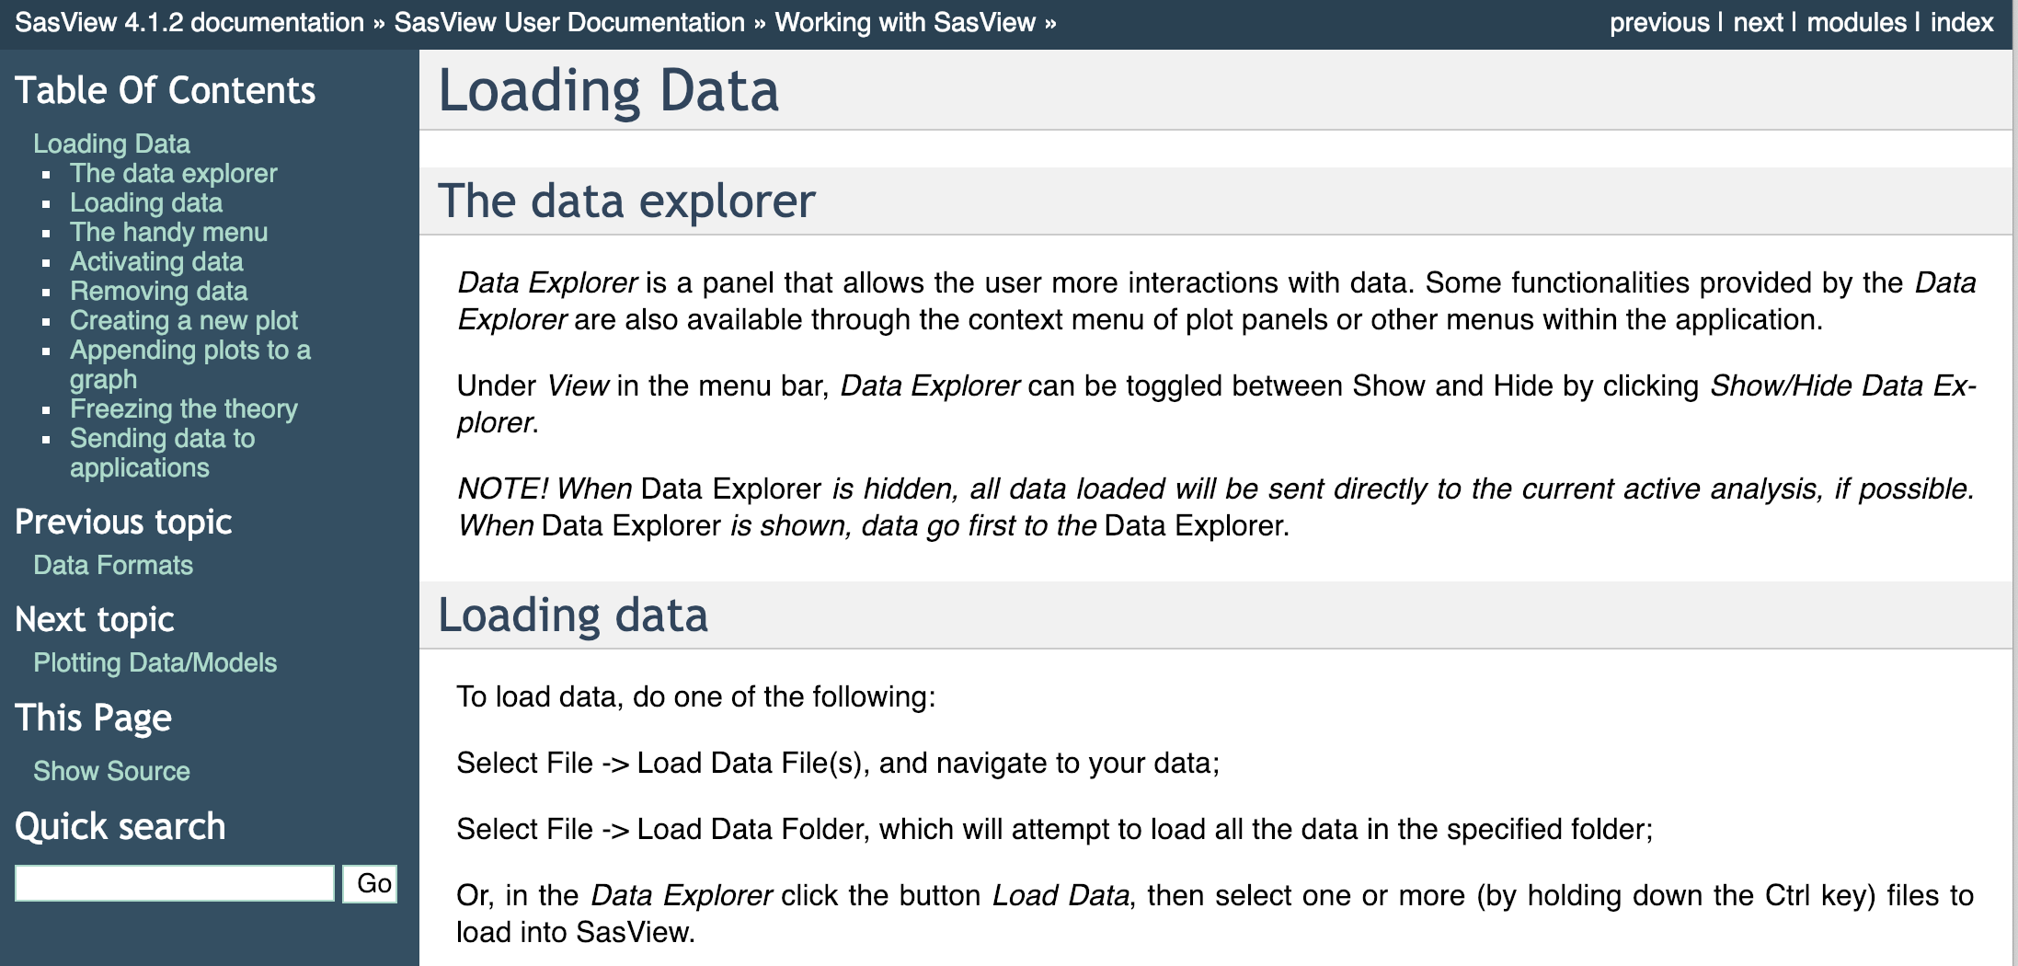
Resources, Education & Outreach
Website
Documentation
Written Tutorials
Video Tutorials (YouTube)
Taught courses
Scattering schools
University courses
E-learning
Twitter
Slack
Mailing Lists
Bootcamps & Regional Workshops
(Marketplace)

Slide 16
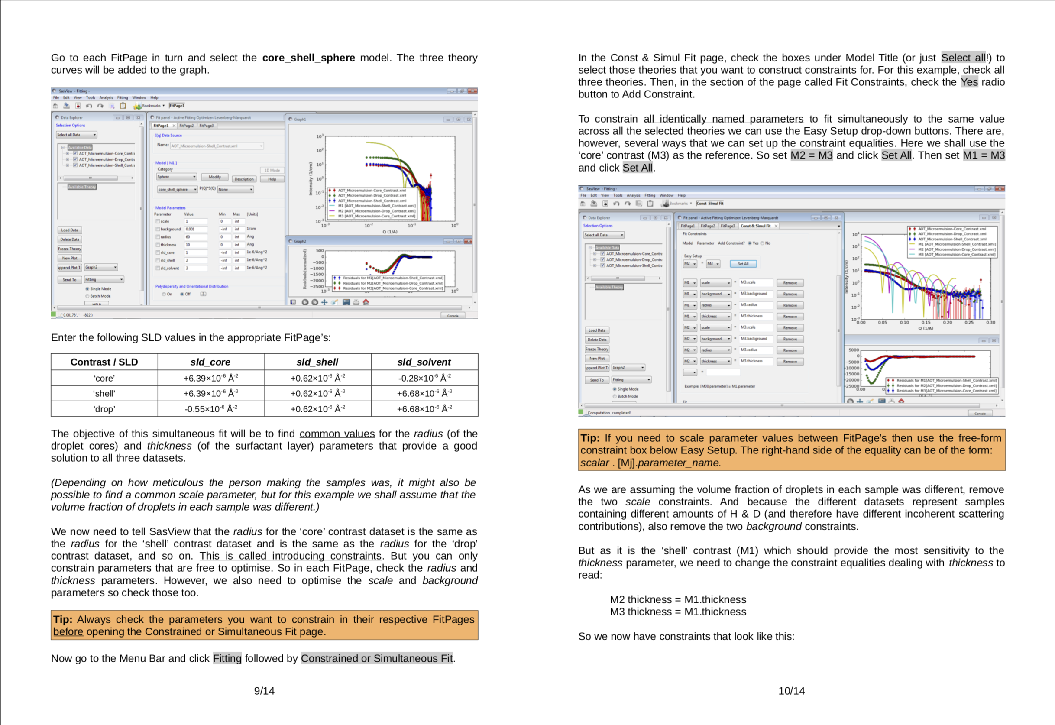
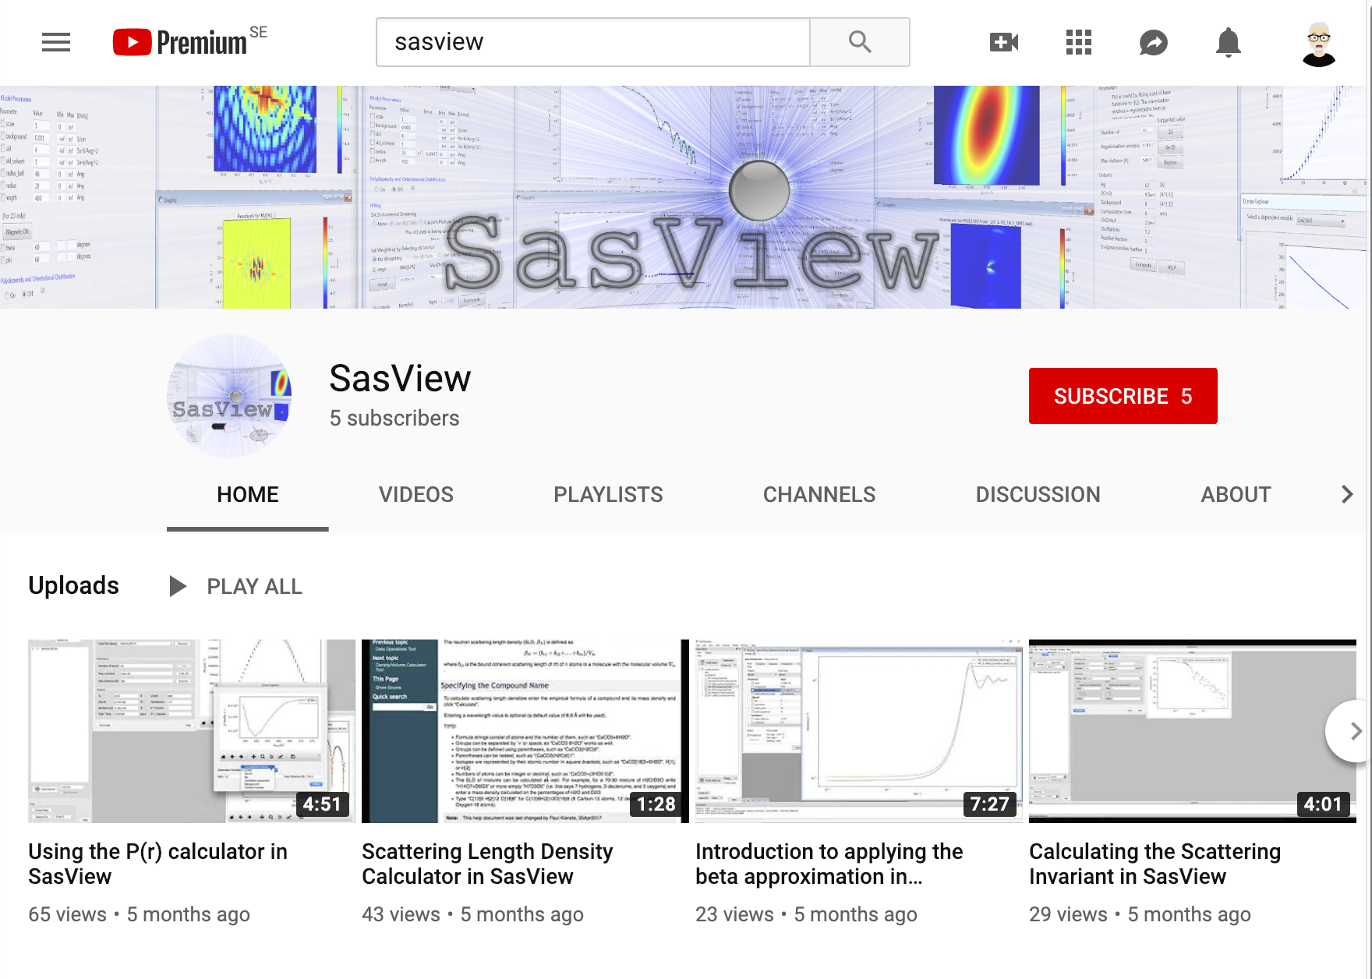
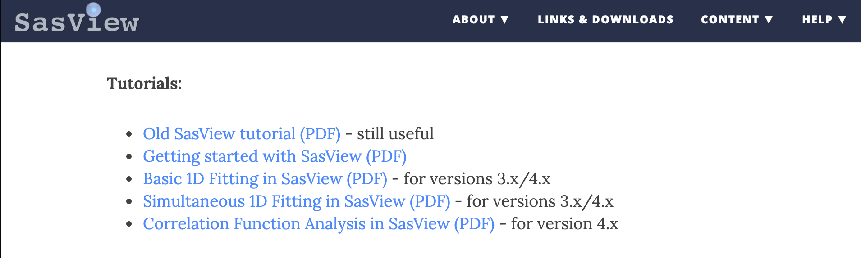
Resources, Education & Outreach
Website
Documentation
Written Tutorials
Video Tutorials (YouTube)
Taught courses
Scattering schools
University courses
E-learning
Twitter
Slack
Mailing Lists
Bootcamps & Regional Workshops
(Marketplace)

Slide 17
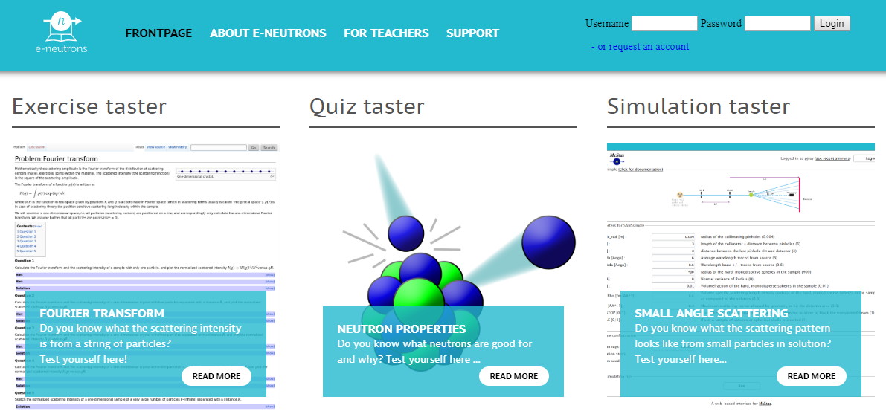

Resources, Education & Outreach
Website
Documentation
Written Tutorials
Video Tutorials (YouTube)
Taught courses
Scattering schools
University courses
E-learning
Twitter
Slack
Mailing Lists
Bootcamps & Regional Workshops
(Marketplace)
All the work of ISIS Sandwich Student Michael Oakley

Slide 18

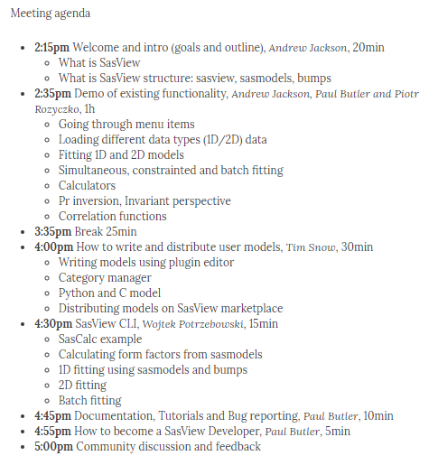
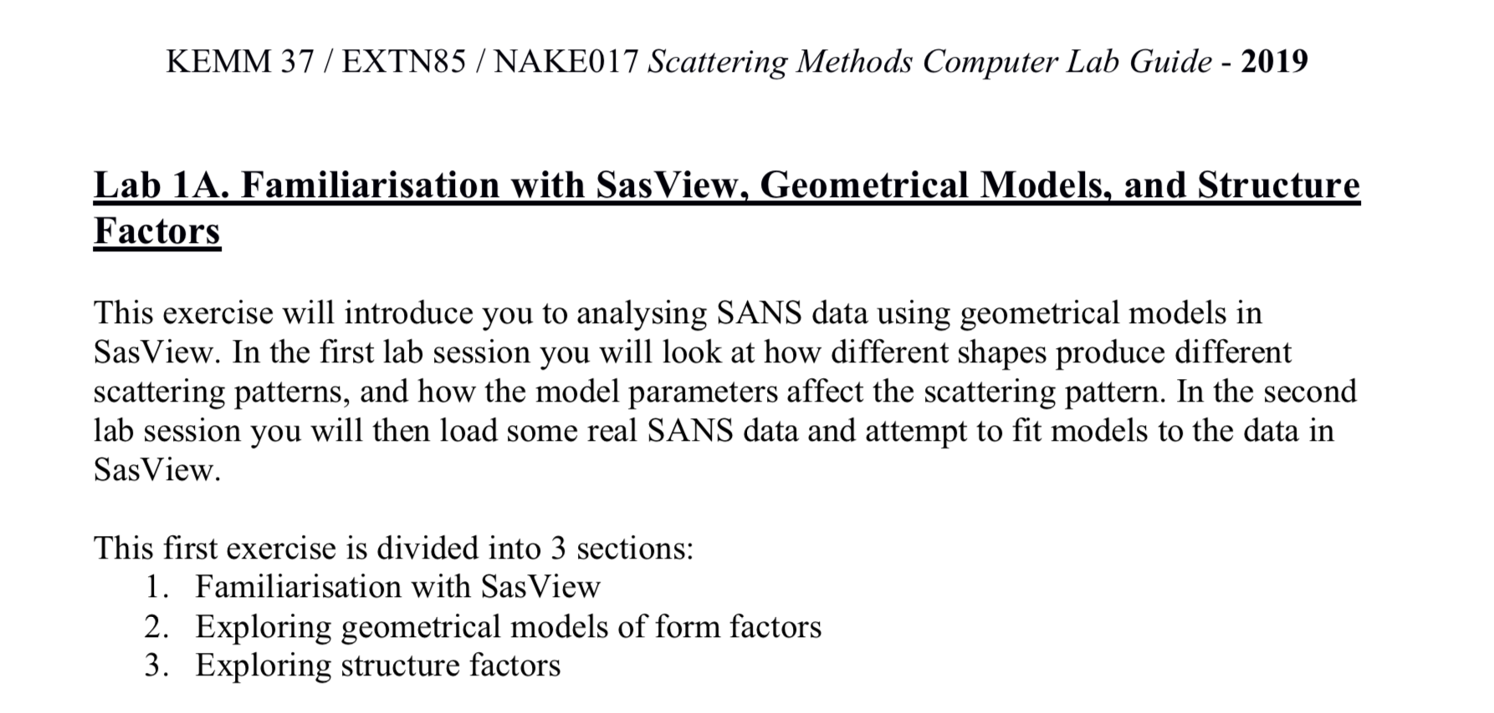
Resources, Education & Outreach
Website
Documentation
Written Tutorials
Video Tutorials (YouTube)
Taught courses
Scattering schools
University courses
E-learning
Twitter
Slack
Mailing lists
Bootcamps & Regional Workshops
(Marketplace)

Slide 19
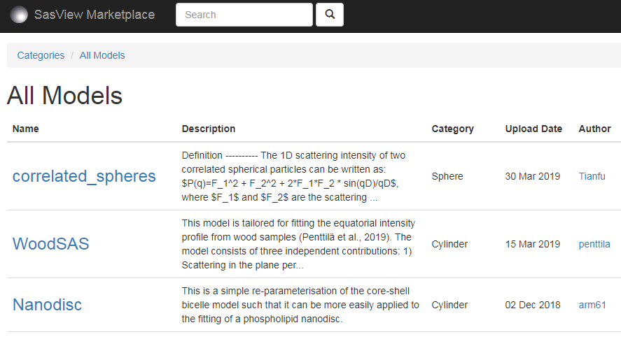
Resources, Education & Outreach
Website
Documentation
Written Tutorials
Video Tutorials (YouTube)
Taught courses
Scattering schools
University courses
Bootcamps & Regional Workshops
E-learning
Twitter
Slack
Mailing Lists
(Marketplace)
All the work of ISIS Summer Student Lewis O’Driscoll
Uses mySQL & Postgress
8 models contributed by 7 authors in 2 years

Slide 20
So … Where is SasView Going? What will it do for me?
Notes:
But to answer this question we first need to understand a bit about how SasView is developed.

Slide 21
Scientific Software Development and
The cyberinfrastructure revolution
Never enough resources to achieve the vision we have
No resources for long term maintenance and support.
Problem:
To reap the benefit of investment in software developments requires foundational long term support.
If entity that supports the development also must support the "maintenance" forever, the entity will soon cease to be able to fund new projects.
CONCLUSION: This paradigm is broken!!!
FACTS OF LIFE:
Resources are finite
Needs are infinite

Slide 22
Analysis Software - Who’s Job is it Anyway?
Analysis is where the science is → the USER’S JOB
Scattering is an analysis tool and part of providing the tool should be the necessary software → the FACILITY’S JOB
Data sat on disk is useless to EVERYBODY
We need to work together!

Slide 23
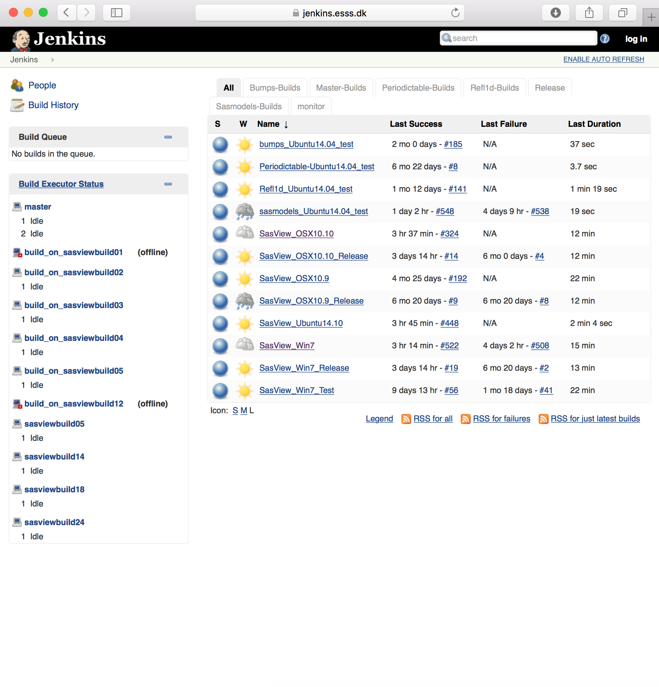
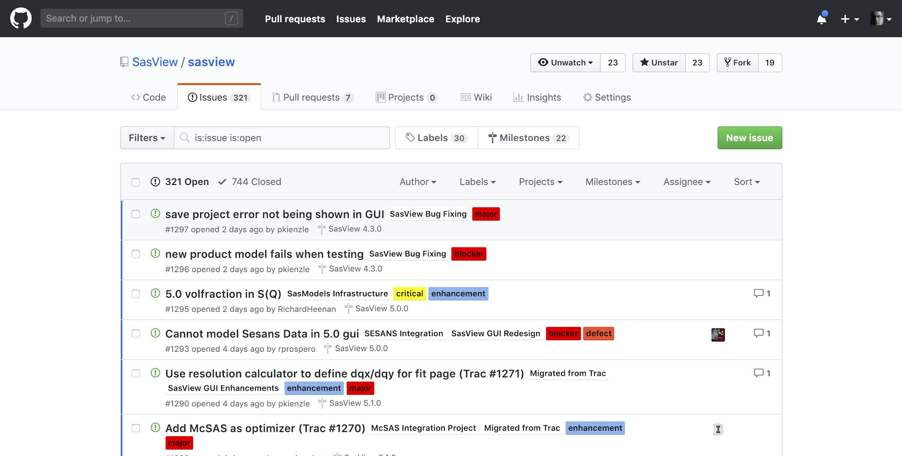
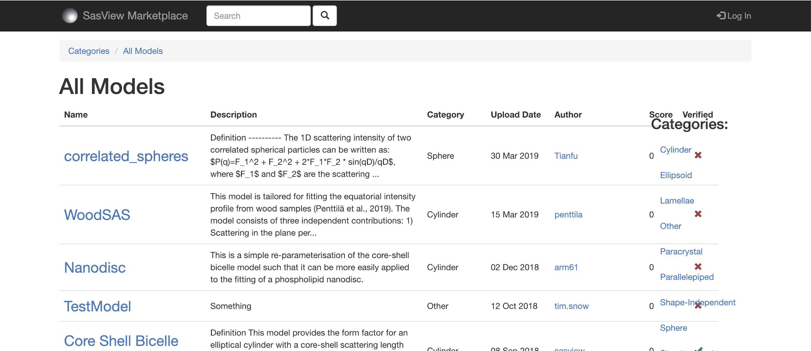
How We Work
Open, Collaborative, Community Development
Code is open source and publicly hosted at Github
Released under BSD 3-clause license
Bug and Enhancement Ticket System
Bi-weekly developer calls
Code Camps
5 Year Roadmap
Model Marketplace
DOI for each release
Code Hosting, Task and bug tracking, and developer/user wiki
Github
Model Marketplace for users to share their models
marketplace.sasview.org
Automated Builds
build.sasview.org
http://www.sasview.org
http://github.com/SasView

Slide 24
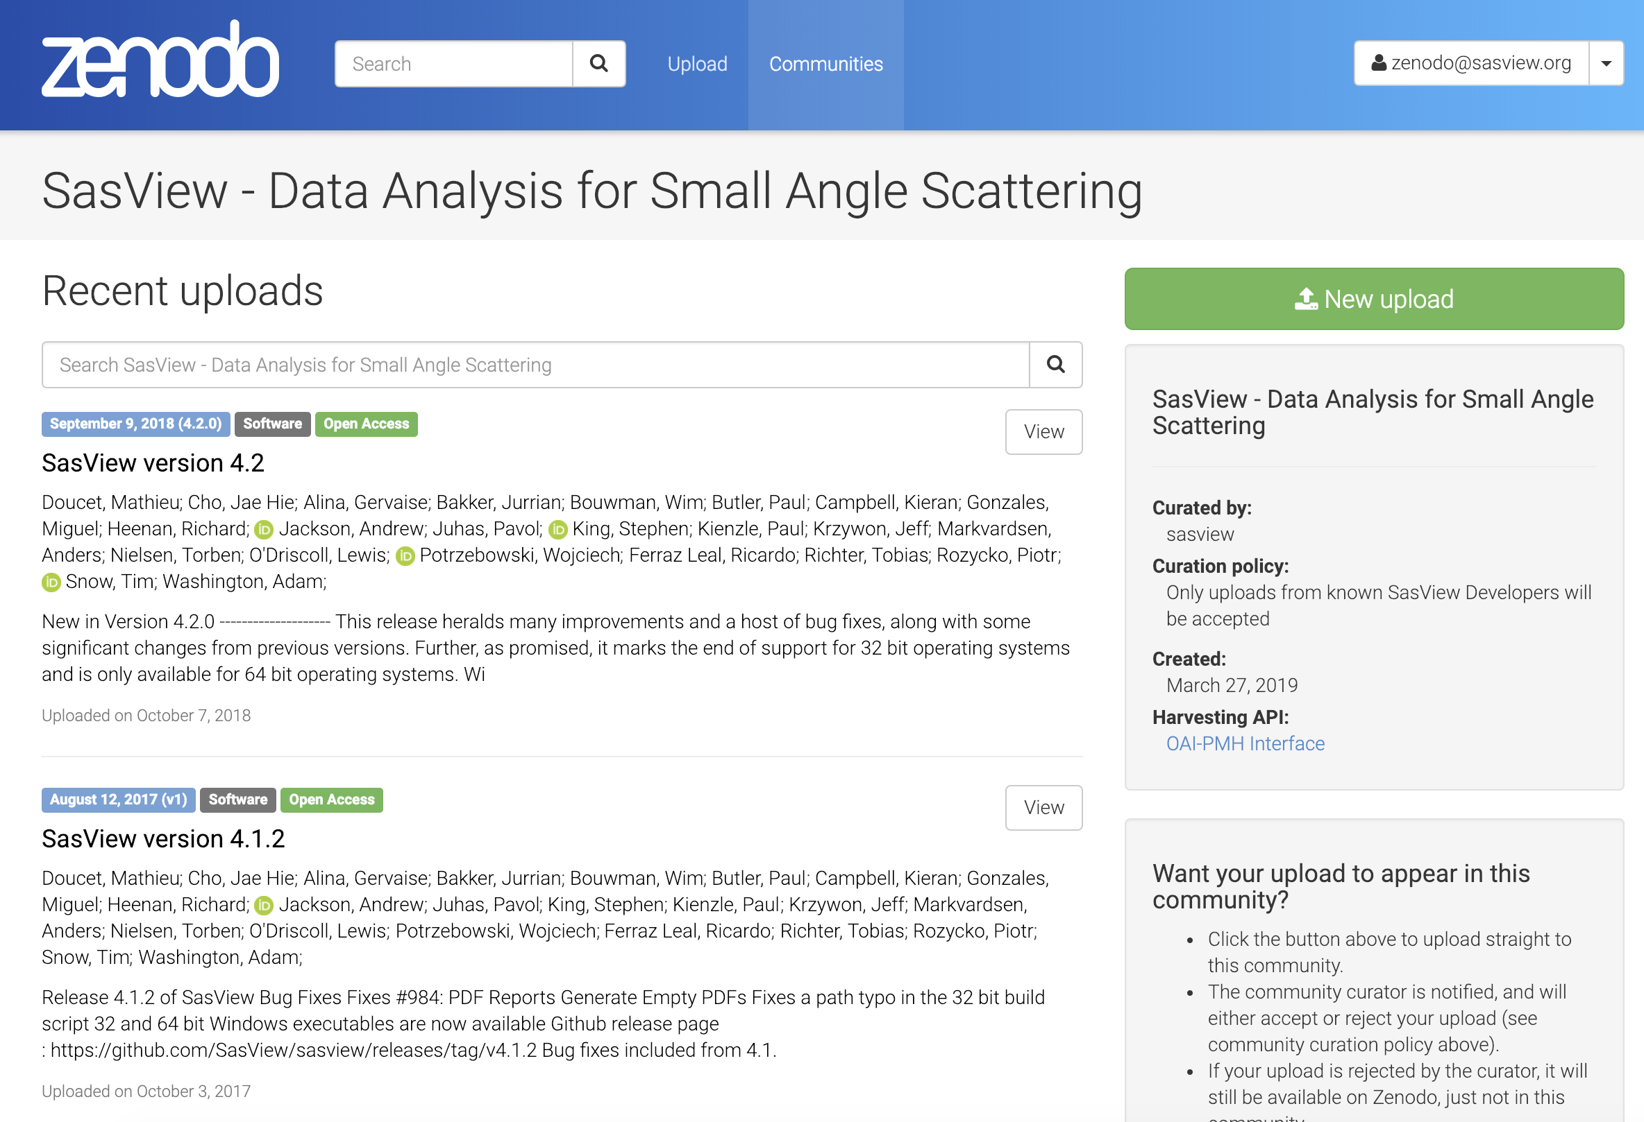
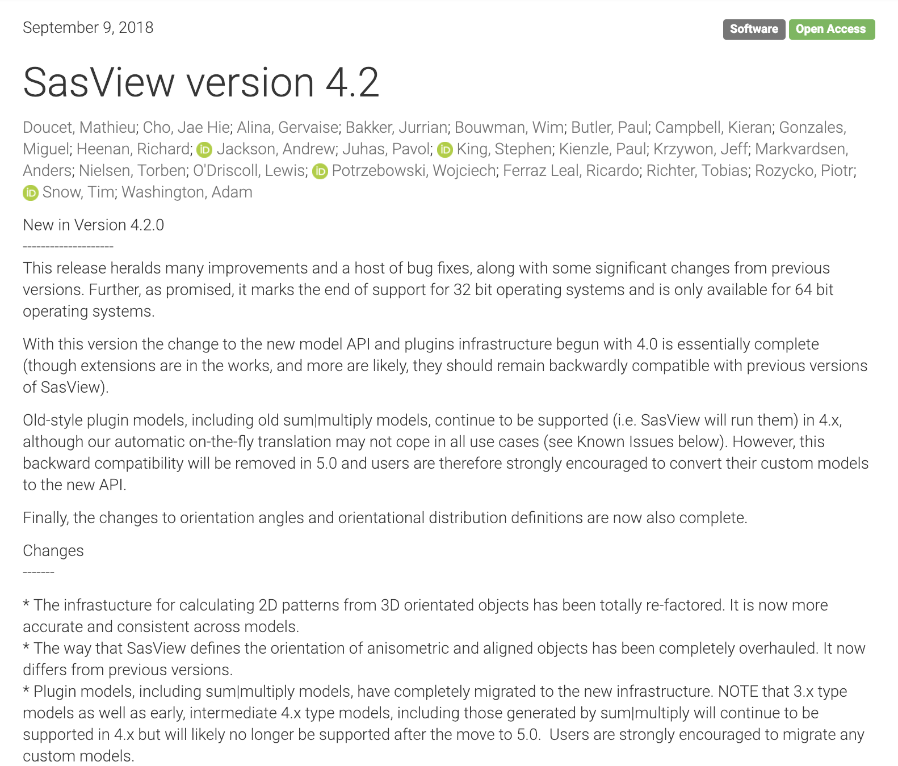
How We Work
Open, Collaborative, Community Development
DOI for each release
https://zenodo.org/communities/sasview-analysis
http://www.sasview.org
http://github.com/SasView

Slide 25
How We Work
Open, Collaborative, Community Development
We work together towards common goals formulated through community input, with two guiding principles ...
He who pays the piper …
Those who bring the resources (time and effort, or funds to buy time and effort) choose what to work on.
You break it, you bought it ...
You are not allowed to break what is already there for others. If you break it, you fix it.
http://www.sasview.org
http://github.com/SasView

Slide 26
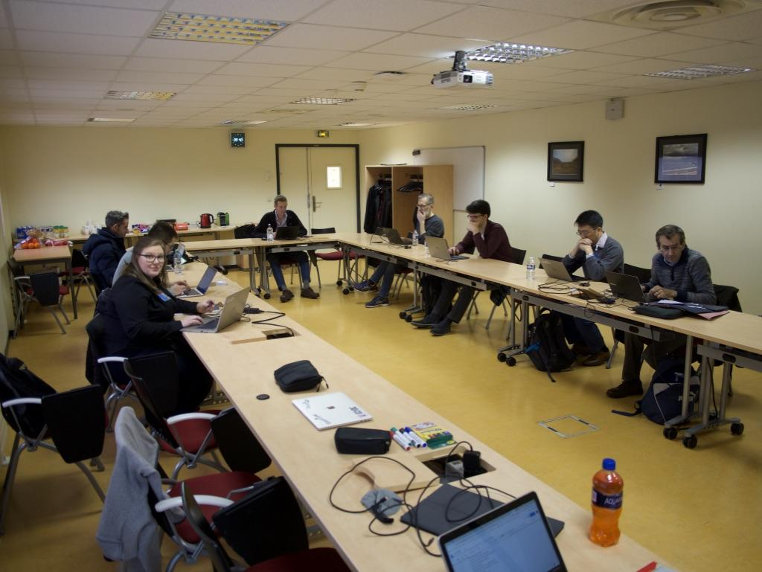
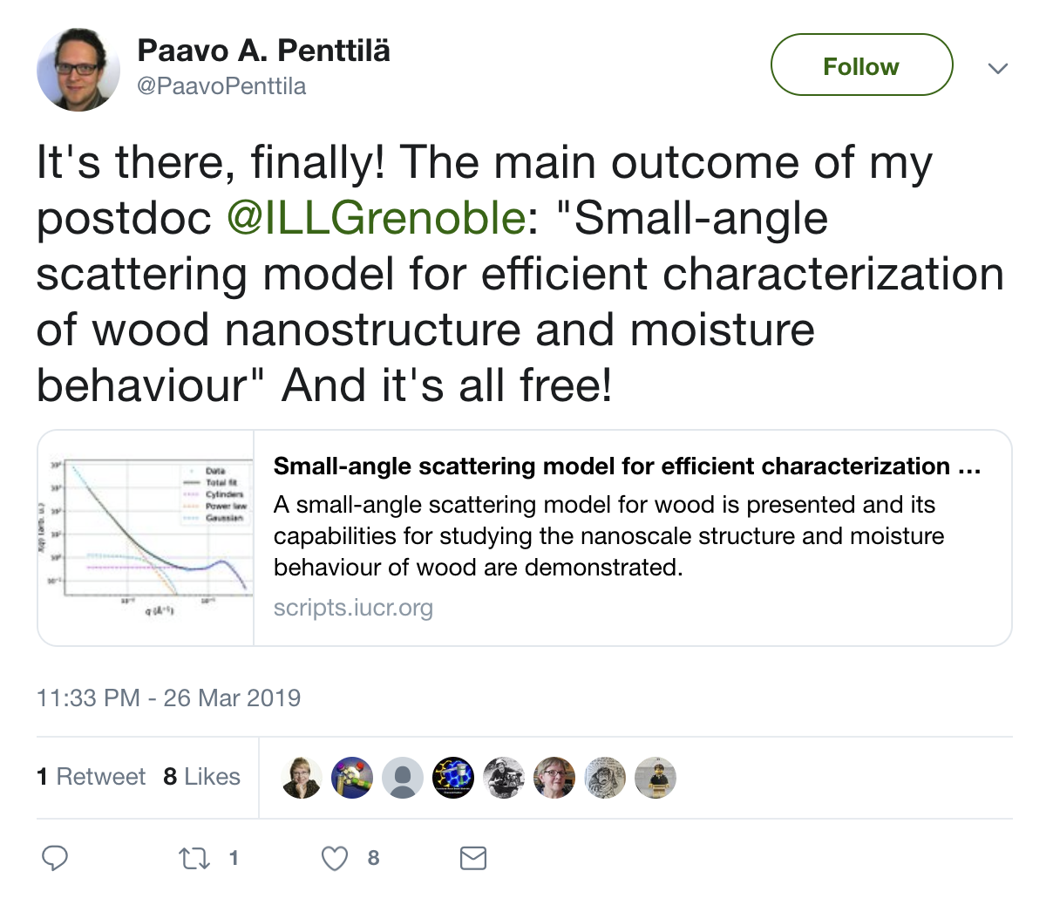
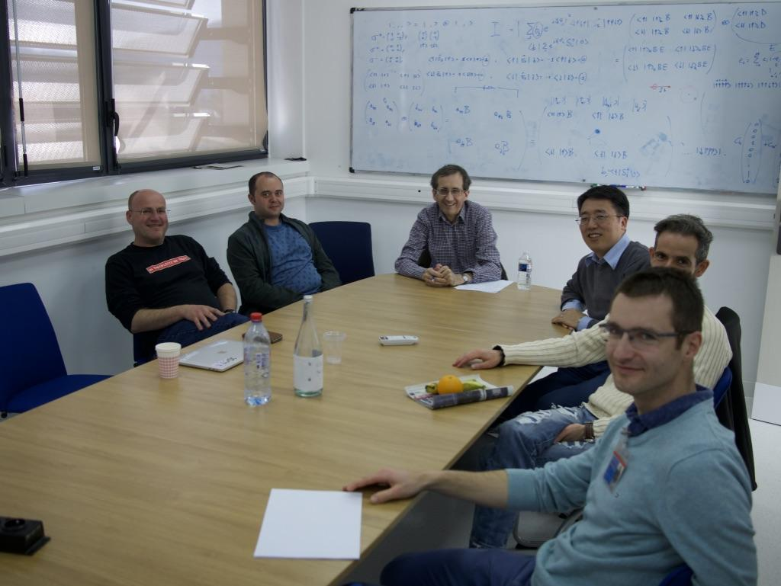
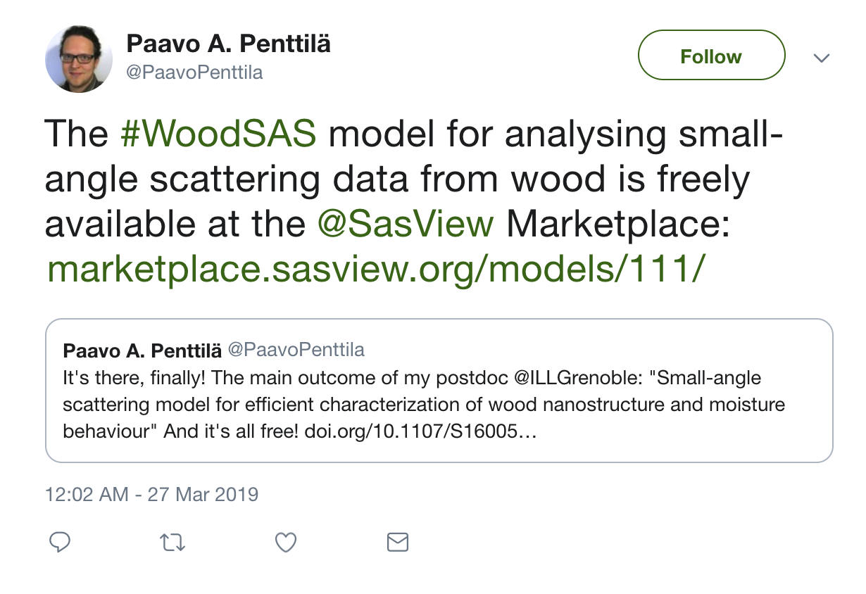
How We Work
Open, Collaborative, Community Development
Ask not what the community is going to do for you,
ask what you can do for the community
P. Butler, March 2019
http://www.sasview.org
http://github.com/SasView

Slide 27
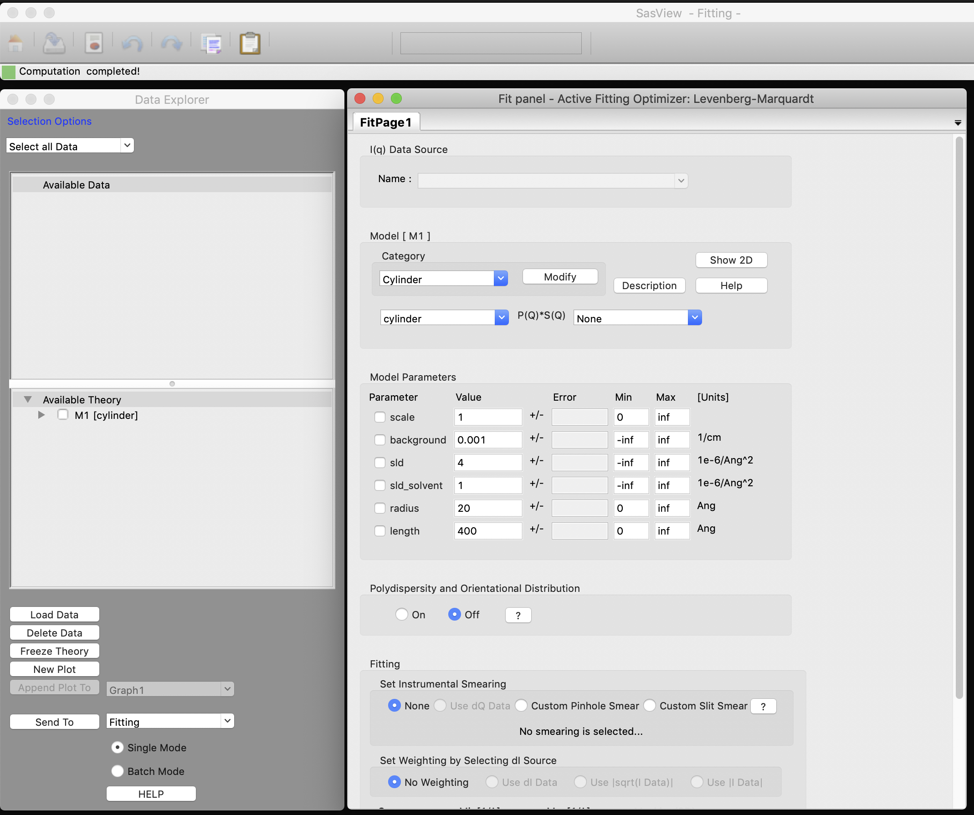
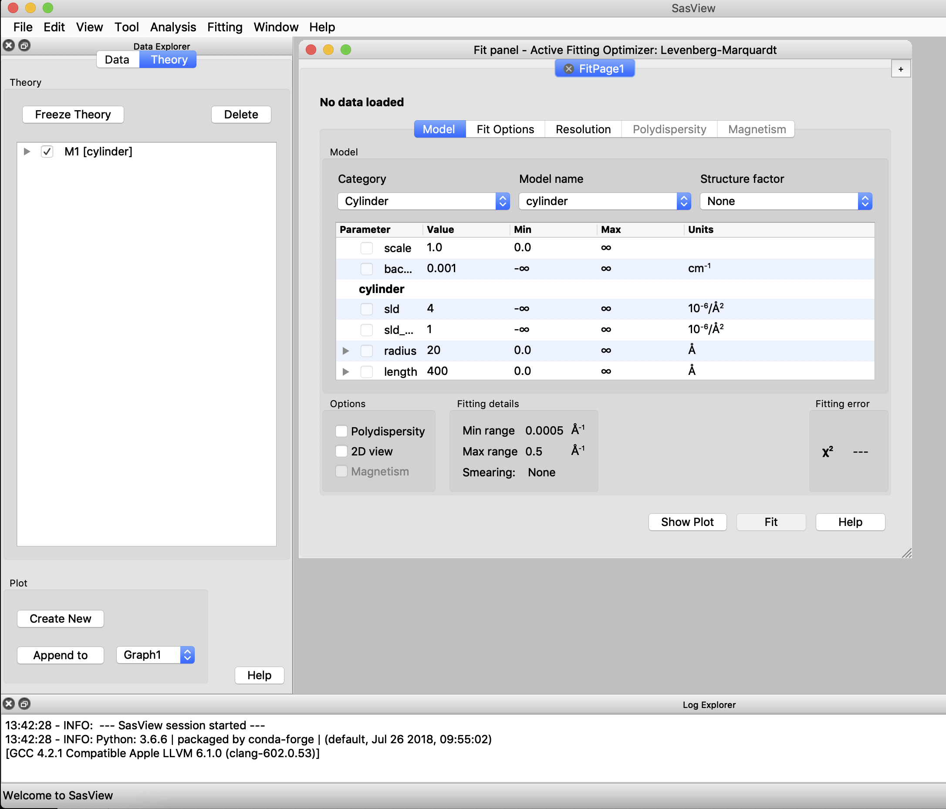
SINE 2020 Work - GUI
wxPython
Computation and GUI code mixed
“Organically developed” - hard for new developers
PyQT
Computation, GUI code, and models separated
Structured and documented - easier for new developers

Slide 28
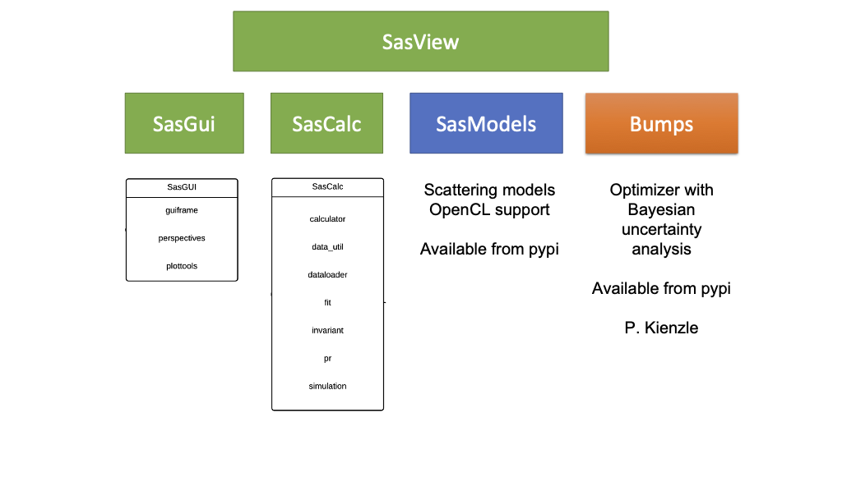
SINE 2020 Work - Code Separation

Slide 29
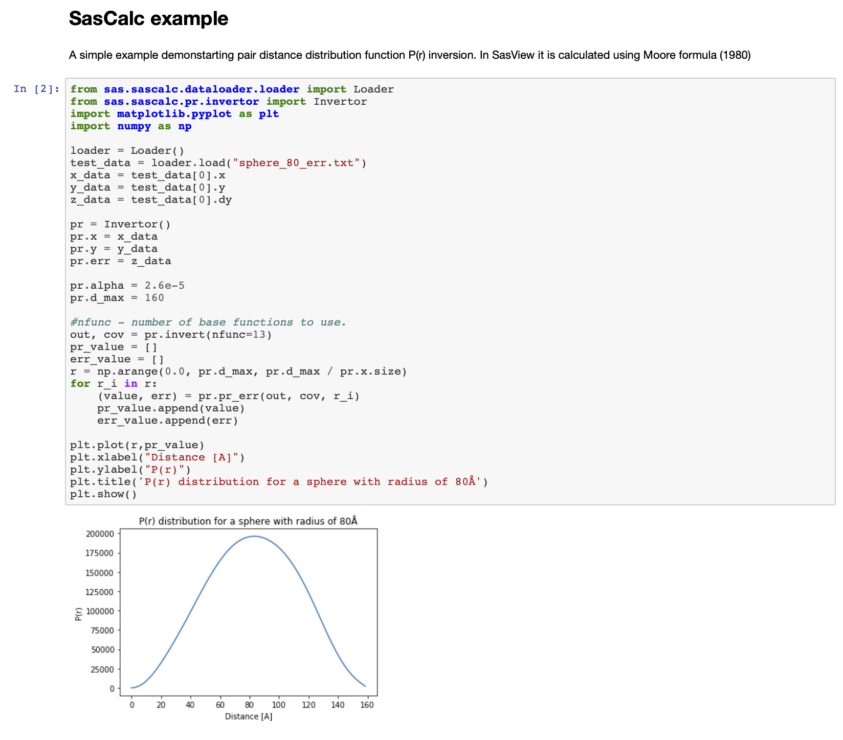
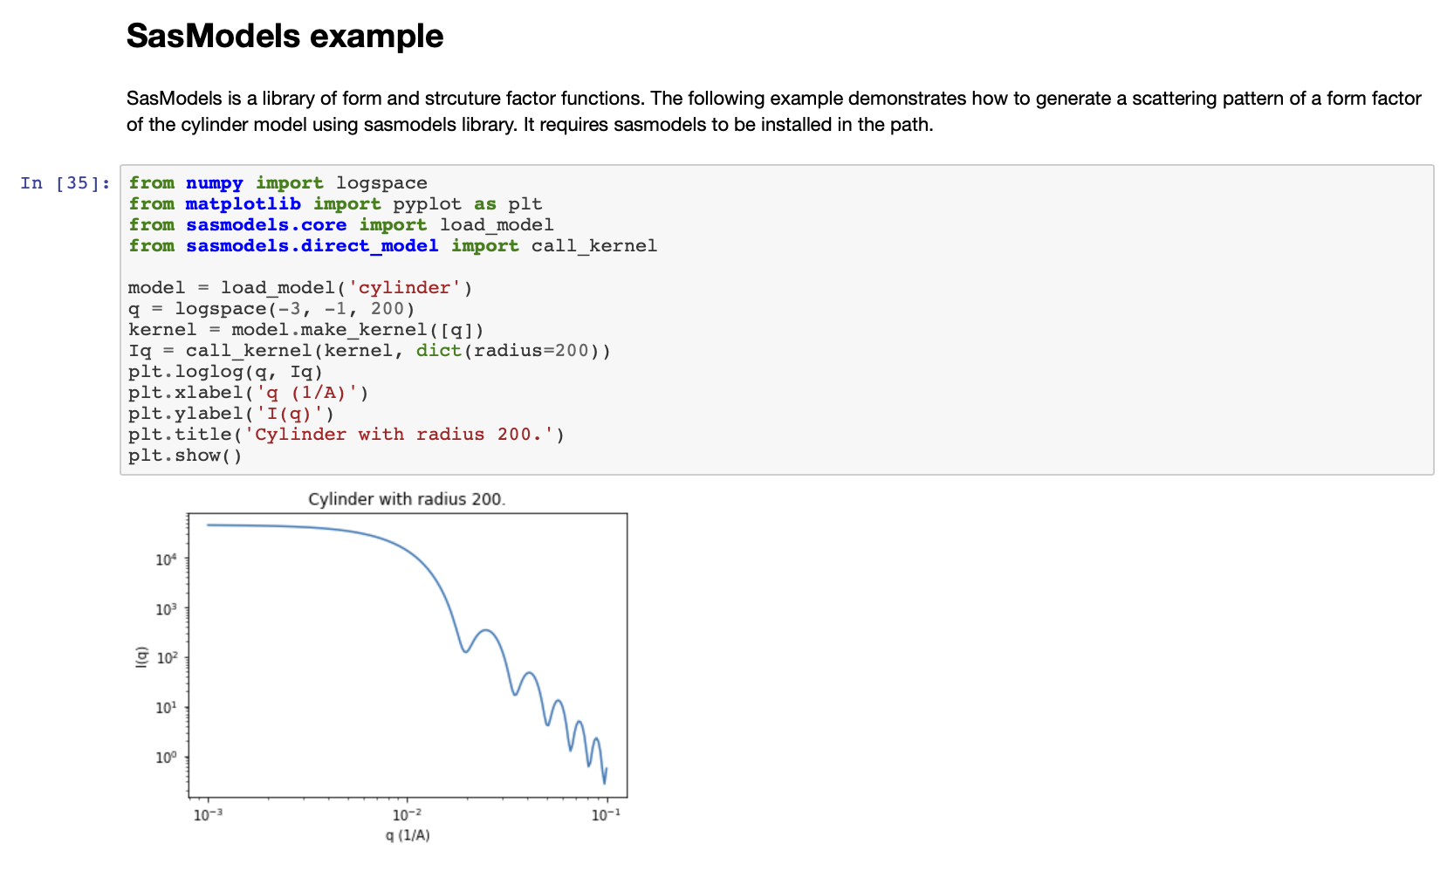
Jupyter Notebooks

Slide 30
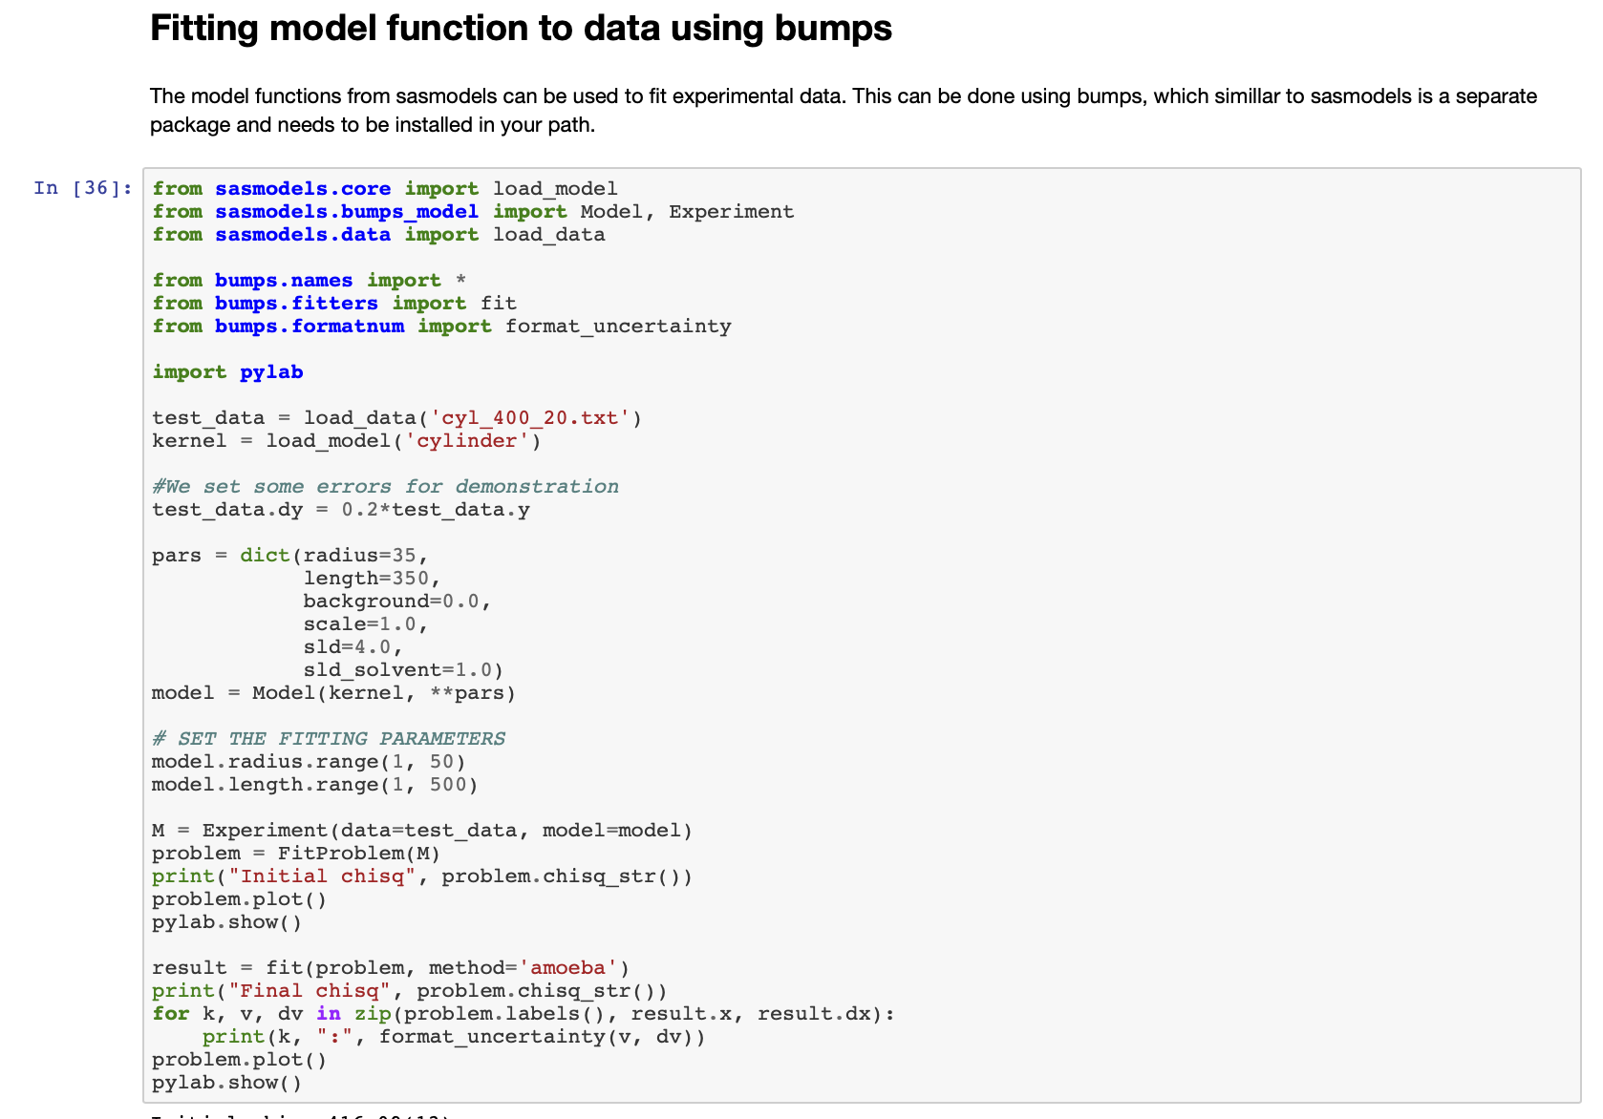
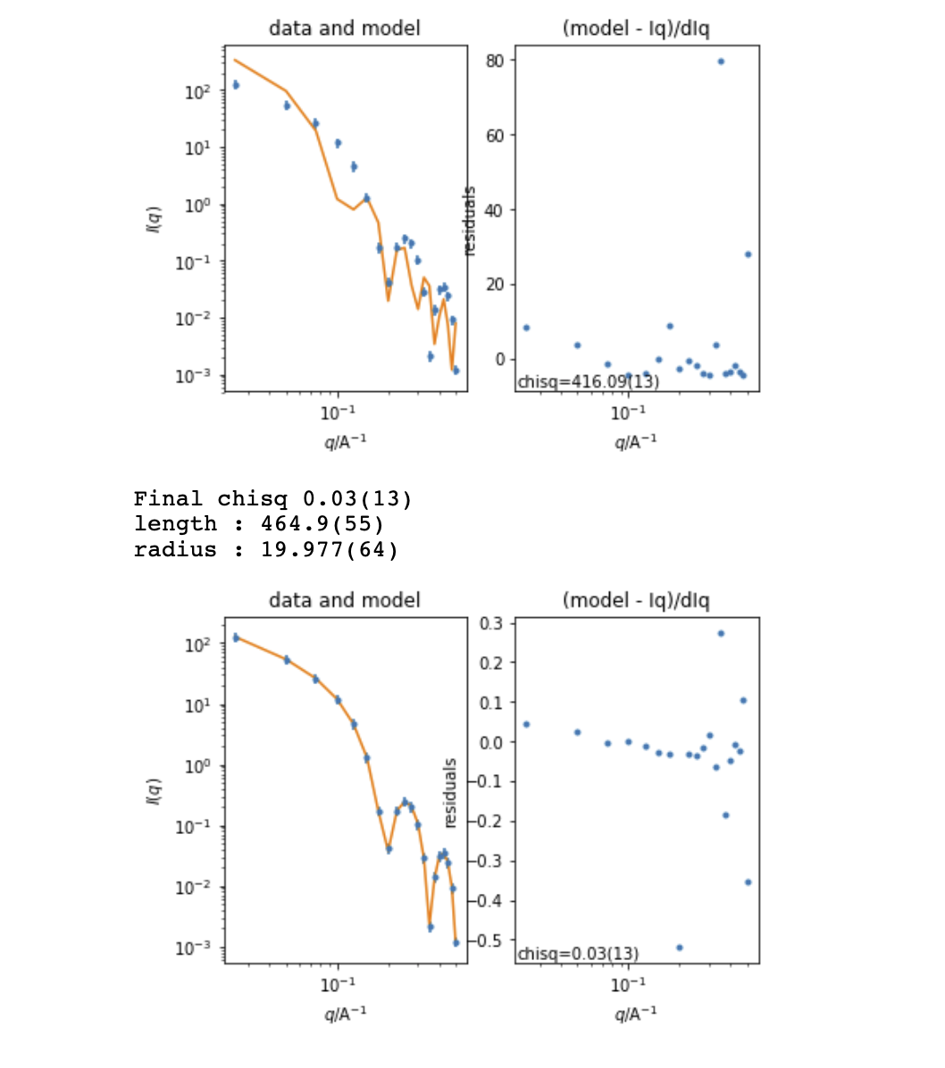
Jupyter Notebooks

Slide 31
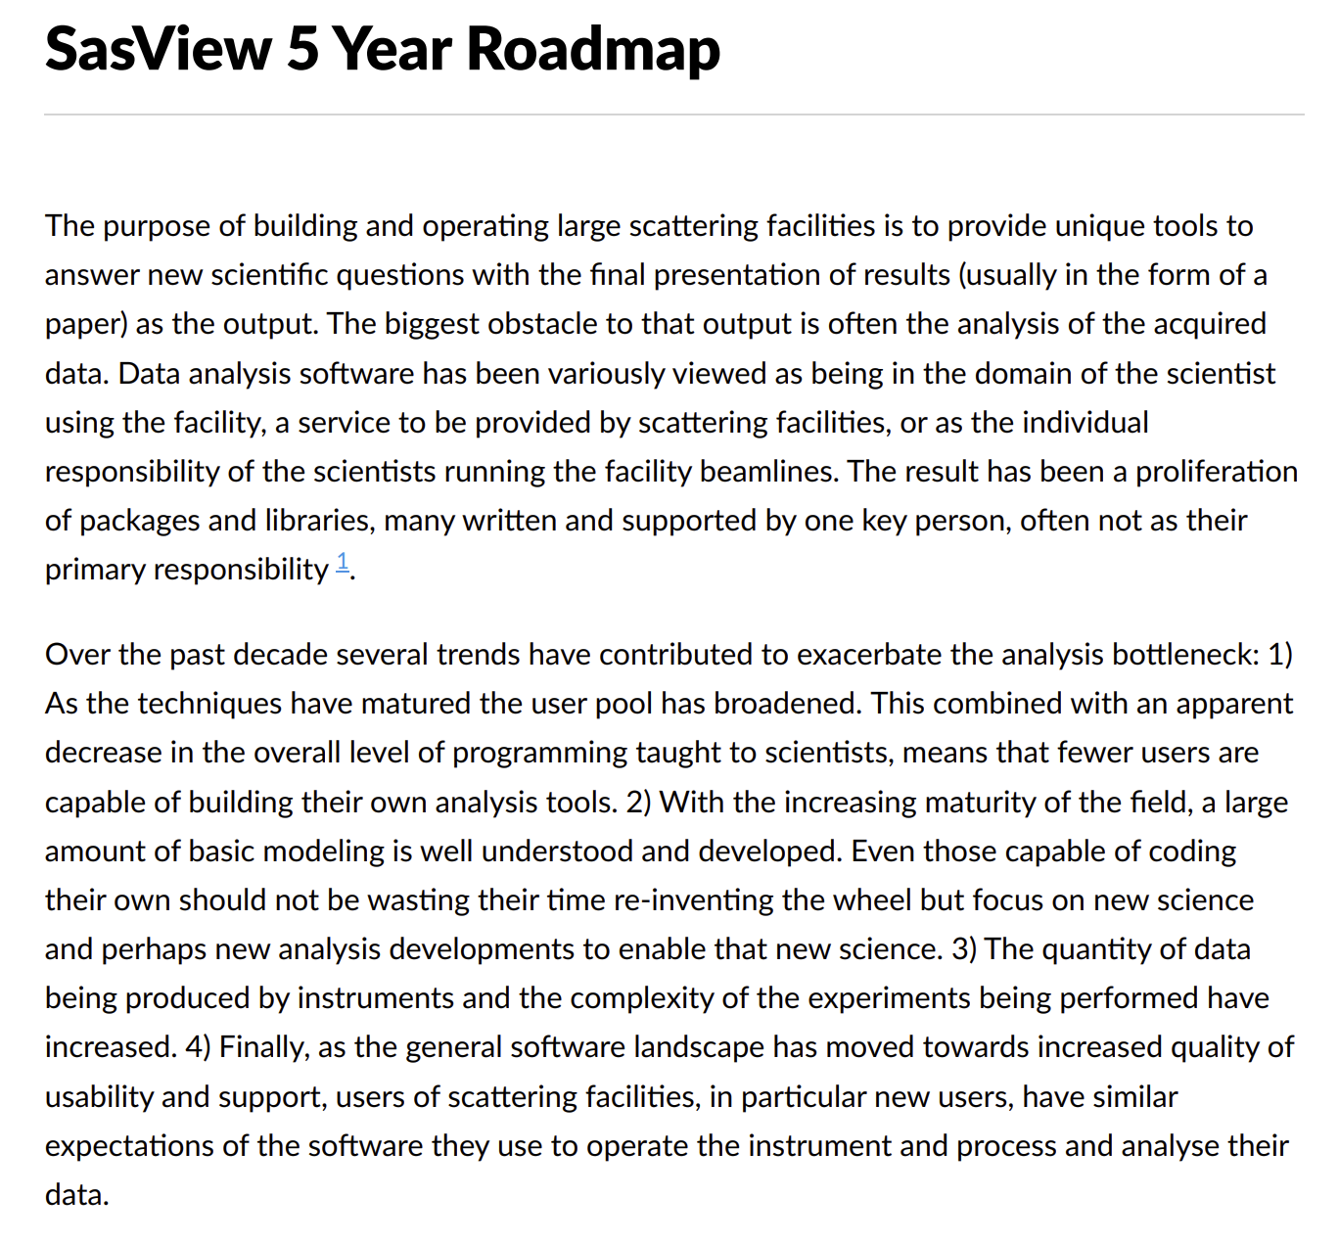

The RoadMap
Living document
Directs work for developers and helps find candidate projects for funding.
Discussed and updated at each Code Camp.
https://github.com/SasView/documents

Slide 32
Roadmap Late 2018 to mid 2019
Move focus of all GUI efforts to the new Qt GUI Done. Major bug fixes only to 4.x GUI
Parallel development and release tracks (5.x + 4.x) Working, but needs streamlining from 5.0 release
Complete beta approximation work In testing
New, more flexible interaction volumes/radii Underway?
Community meeting at SAS 2018 Done
Complete SasView paper Started
Consolidate and extend training material - both written tutorials and hands-on training material. Ongoing
Update model marketplace Needs developer
Create plan for developing community interactions. Started
Fixes to custom model editor to support polydispersity Done
Incorporation of models from:
SASFit^7 Work done, but not shipping by default. https://github.com/SasView/sasfit-models
Scatter^8 (Förster - crystalline materials models primarily) In discussions with BornAgain team
Project infrastructure cleanup:
ticket review/cull given 5.0 release Ongoing
possible move to GitHub issues. Underway
Release
5.0 alpha (late 2018) Done
5.0 beta (early 2019) Done
5.0 (mid 2019) On track
4.2 Done
Not in roadmap for this period …
Complete separation of sascalc package / headless usage
https://github.com/SasView/documents

Slide 33
SasView 4.x series - 4.2.1 current
www.sasview.org
Official Releases available for Windows, Mac, and Debian Linux
Models
New models
New model package (sasmodels)
Separation of models from GUI
Simpler addition of models by users
Speed! GPU and parallel processing
New, consistent approach to orientation distributions for 2D
Correlation Function Analysis
CCP13 corfunc algorithm
Documentation
Enhanced, updated documentation for models.
New Tutorials.
SESANS
Automatic transform of SANS model to P(z)
Plotting and fitting of SESANS data from GUI
Example scripts for fitting SESANS data
Simultaneous fitting of SANS & SESANS
Notes:
4.2 key points:
Orientation distributions
Bug fixes for plugin models
Many other bug fixes – see release notes!

Slide 34
SasView – the Next Generation – 5.x
Parallel release of 4.x and 5.x until 5 series is stable. 5.0 beta-2 release out now for testing!
UI Refactoring (“SasView 5.0”)
Move to QT - current and well supported toolkit
Complete separation of GUI and calculation code
Provision of CLI & updated Python API
Release 5.0
Sasmodels Enhancements
Return F(q) from models
Beta approximation
Coherent sums
Constraints refactor
Multi-GPU support
Inclusion of SasFit models
Target release - 5.0
Target release - 5.1
Target release - 5.0
Integration of McSAS
Integration of PyPrism?
Implementation of key models from Scatter
Target release - 5.1
Documentation
Tutorials – written, interactive & video
Manual
And much more!
See Roadmap and Tickets

Slide 35
Status of contributor community
“Management” Team
9 facilities
40 contributors on github (does not count original team)
about 15 “active” at any one time
Paul Butler (NIST)
Mathieu Doucet (ORNL)
Andrew Jackson (ESS)
Steve King (STFC)
New people … now getting student interest
Dominique Dressen (Sabrina Dish student Colone Uni)
Rachel Ford (Julia Kornfield student Caltech)
CARR (Tianfu and Dongfeng)
CSNS (could not come due to visa)
NSLSII → conda forge and deploy on their instruments
ALS using sasmodels
Users submitting models to marketplace

Slide 36
So … Where is SasView Going? What will it do for me?
Notes:
But to answer this question we first need to understand a bit about how SasView is developed.

Slide 37

Saview Bootcamp? Training courses?
Open, Collaborative, Community Development
Ask not what the community is going to do for you,
ask what you can do for the community
P. Butler, March 2019
Day One = Using SasView
morning = overview lectures
Afternoon = hands-on/tutorial
Day Two = Write your own model - hands-on
Day Three = using sasview via scripting
Morning = Python tutorial
Afternoon = Intro to scripting with Jupyter Notebook and using to script sasview
Day Four = Contribute - preparation for code camp
includes contributing to tutorials, documentation, checking and fixing math, adding tests, reporting using issues, GUI framework code, marketplace database, etc.
https://github.com/SasView/documents/blob/master/Training/SasView_Boot_Camp/syllabus.md
http://www.sasview.org
http://github.com/SasView

Slide 38




Come and Join the Fun!
Things people are saying about SansView/SasView
‘SansView is a very helpful tool, very complete and easy to use’ - Niki
‘I want to thank you for this amazing software. It’s UI and options make the interpretation of spectra easier and faster’ - Philippe
‘I really like the SasView software’ - Martin
‘I have been using SasView as my software of choice for fitting SANS data, and I have been very happy with the software’ - Greg
‘I have found SasView very easy to use and the batch fit function is a wonderful time saving tool. I can finally stop making painful excel macros!’ - Andrew
‘I am a new user of SasView and I think it is a very useful and practical tool’ - Arnaud
‘Within 30 seconds…I am completely converted to SasView!’ - Mike
‘Thank you for creating and maintaining SasView. It is an incredibly helpful tool, and I use it regularly’ - Pasha
‘All the best and thank you again to carry on such a good job on SasView’ - Niki
‘Ooooh NICE PROGRAMME!! Hours of fun!’ - Stuart
‘I love such amazing software so much. It help our researches a lot.’ - Po-Wei

Slide 39

Questions?

Slide 40
Roadmap Late 2019 to mid 2020
Begin model fitting refactoring work to allow custom re-parameterization of models, allow reading in an array representing either PQ or SQ for P*S fits, fitting oriented model to 1D cuts including revisiting orientation definitions etc. Discussed at this code camp
Complete architecture manual
Begin work on refactoring constrained/simultaneous fits.
Begin work on adding custom workflows identified as highest priority
Work to update tutorials to support 5.x
Begin work on advanced model fitting tutorial
Usual bug fixes and other minor improvements as time and interest permit
Integration of McSAS
Begin work on generic O-Z solver
Inclusion of PRISM^9 functionality
Begin work to refactor/improve generic scattering calculator
Improvements to custom model editors including features from compare.py
Support for multi-GPU, multi-CPU and CPU/GPU computation
https://github.com/SasView/documents

Slide 41
Roadmap mid 2020 to mid 2024
Refactor Simultaneous/Constrained fitting - significant changes in 5.0
New Workflows
Web UI (and Phone App)
Headless - essentially done in 5.1?
Intelligent limits/help ⇒ “AI” ?
Add support for ASAXS
Enable transparently running computational code remotely from within local GUI - dependent on headless
https://github.com/SasView/documents

Slide 42


How We Work
Open, Collaborative, Community Development
DOI for each release
https://zenodo.org/communities/sasview-analysis
http://www.sasview.org
http://github.com/SasView

